Slide 1
Towards optimized characterization of maize cultivars in the small-scale farms of the Mutale River catchment based on UAV data and ensemble machine learning algorithms
by
Mfamana Sange
Department Of GIS & Remote Sensing, Faculty Of Science And Agriculture
University Of Fort Hare
Supervisor: Dr N Ndou

Slide 2
Presentation Outline
Introduction
Study area
Methodology
Results and Discussion
Conclusion
References

Slide 3
Introduction
Maize (Zea mays L.) is Africa's number one staple food, accounting for more than half of the continent's energy needs (Ray et al. 2012).
About 200 million people in developing countries in Africa directly consume maize as a staple food (Grote et al., 2021).
In Africa, the development of agriculture has been influenced by small-scale farms, making up much of the agricultural sector (Masters, 2014).
About 3.1 million hectares of land in this country are used to produce over 8,0 million tons of maize grain each year, a large proportion of which is produced in small scale farms (de Plessis, 2003).
In the Limpopo Province of South Africa, small scale maize farming has contributed to an increase in the number of agricultural production markets (Baloyi, 2010)
The Mutale River catchment provides a sustainable agricultural interventions because of its small-scale, resource-constrained farming systems (Smith, 2019; Johnson & Lee, 2020).

Slide 4
Introduction (Cont’d)
Remote Sensing technology allows for ability to acquire maize crop information without encountering farm plots, acquire maize crop information over a large area, and inaccessible areas in a short period of time (Ngie et al. 2014).
Aster satellite imagery (Schaub et al. 2007), Landsat 8 OLI/TIRS satellite imagery (Nandibewoor et al. 2015), to evaluate the condition of maize varieties through the RGB multispectral images.
These sensors can be of disadvantage when compared to the UAV imagery, with Sentinel-2 being able to provide a moderate spatial resolution ranging from 10 m to 60 m (Drusch et al., 2012).
One main advantage of UAV technology rests in their ability to operate below cloud cover, ensuring that the data collect is not significantly subjected to atmospheric effects (Li et al., 2019)
Spectral characterisation of maize depends on the difference in spectral reflectance at certain wavelengths (Sahoo et al., 2015).
However, similarities in the spectral reflectance patterns of maize and those of other crops makes it difficult to detect and characterize maize cultivars using multispectral sensors alone (Chivasa et al., 2019).

Slide 5
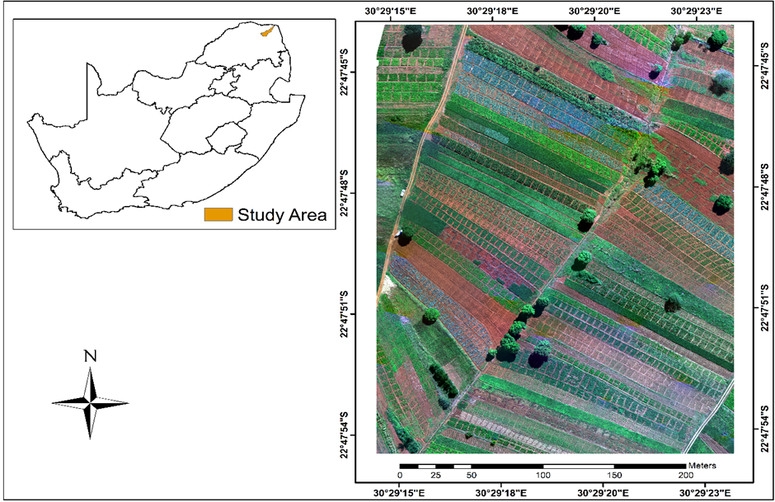
Study Area
The Mutale River catchment is located in the Vhembe District, in the Limpopo province of South Africa.
The geographical coordinates of the area are 22°47'49.93" S, 30°29'15.22" E and 22°47'53.04" S, 30°29'19.38" E
Crop rotation and crop diversification are practices used by farmers in the study area with a range of crops (Mndela et al. 2023).

Slide 6
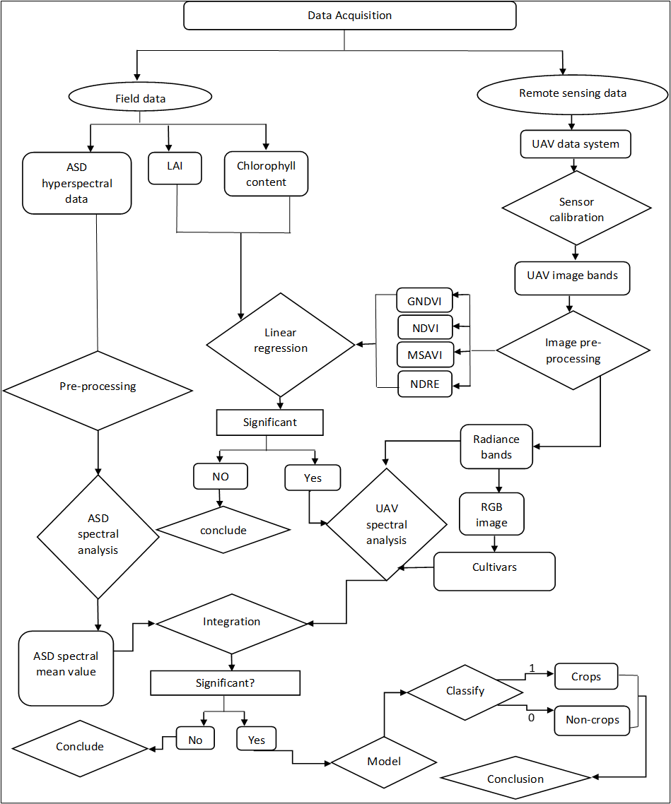
Methods and Methodology

Slide 7
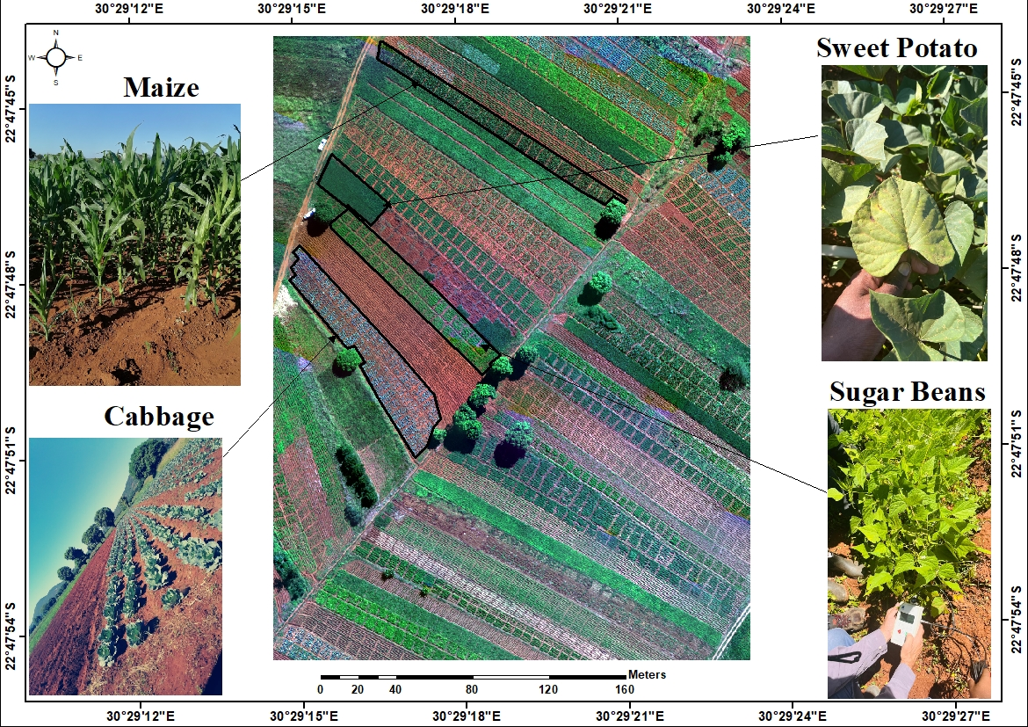
Crops cultivated in the study site

Slide 8
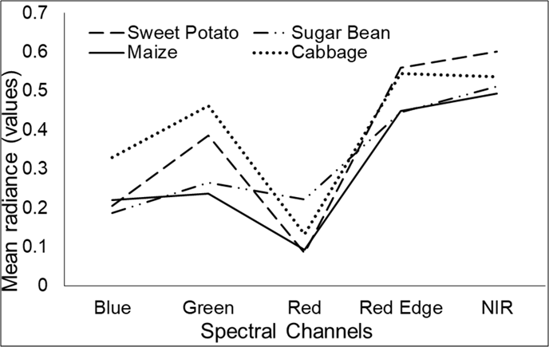
RESULTS -Spectral radiance patterns of various crops from the UAV imagery.
The spectral radiance pattern of maize cultivar against other crop types across the spectral channels of the UAV data.
Maize cultivars can be distinguished from other crops in the green and NIR spectral channels of the UAV multispectral imagery.

Slide 9
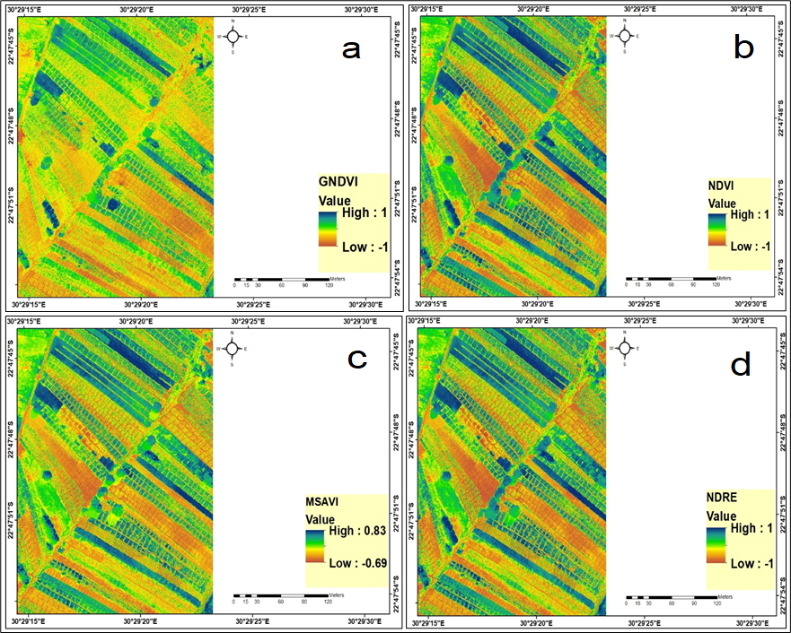
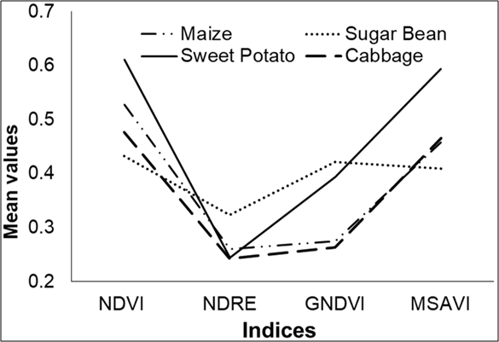
RESULTS (Cont’d) – Vegetation Spectral indices analysis
The vegetation spectral indices obtained from the UAV imagery

Slide 10
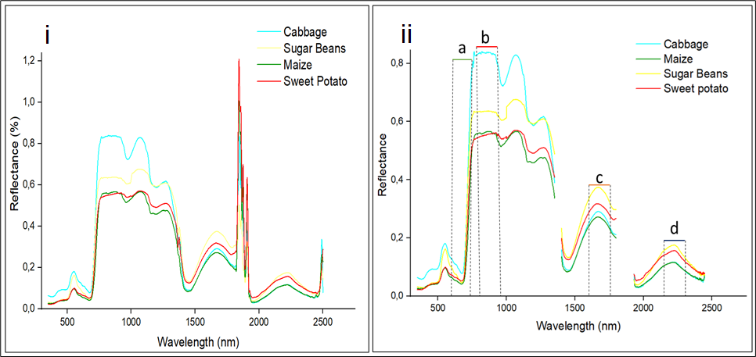
RESULTS (Cont’d)- Hyperspectral data for spectral reflectance for various crops in the study.
The reflectance deviation was obtained in (a) 600 - 800 nm, (b) 810 - 980 nm, (c)1600 - 1790 nm and (d) 2200 - 2350 nm spectral wavelengths.
These spectral wavelengths are the suitable ones form spectrally distinguishing maize cultivars from other crops.

Slide 11
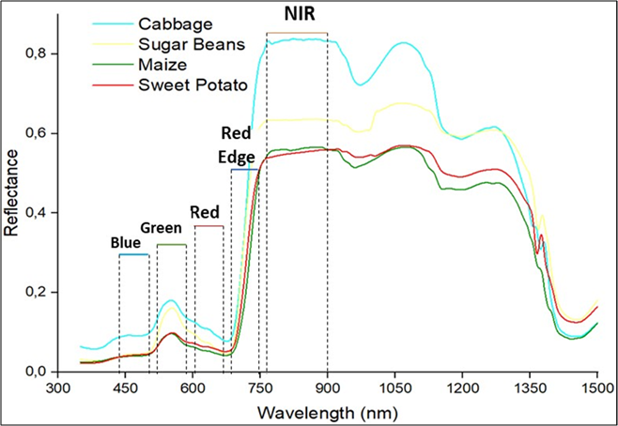
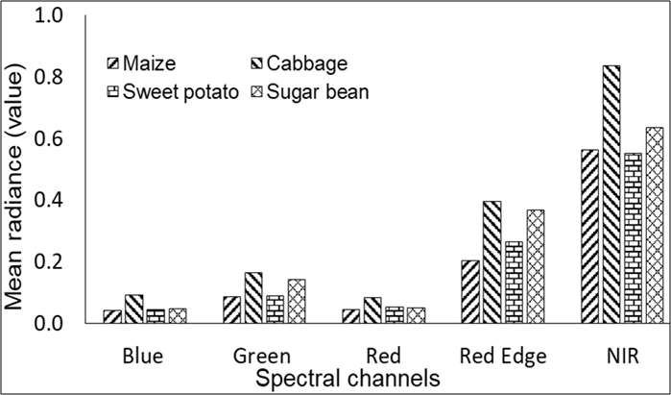
RESULTS (Cont’d) - Reflectance behaviour of maize cultivars in ASD spectral regions corresponding to the UAV spectral wavelengths
Reflectance behaviour of maize cultivars in ASD spectral regions corresponding to the UAV spectral wavelengths
Maize cultivars reflectance was noted to be higher than sweet potato crop reflectance in the NIR spectral wavelength.
By implications, red edge and NIR spectral wavelengths can be used to spectrally distinguish maize cultivars from cabbage, sweet potato and sugar bean crops.

Slide 12
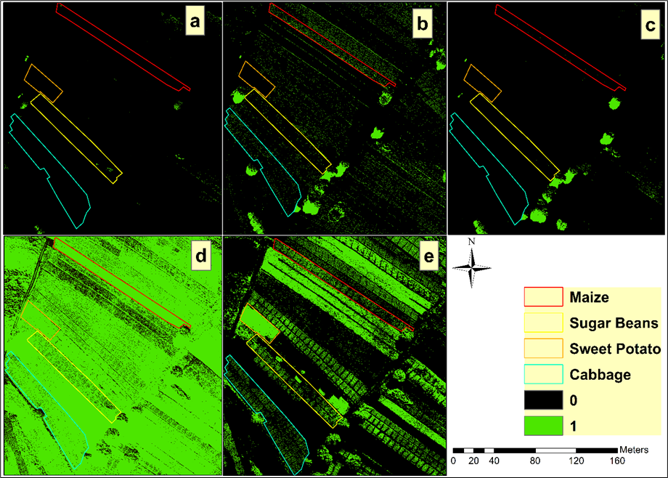
RESULTS (Cont’d) – Demarcation of maize cultivars using thresholding
Demarcation of maize cultivars from (a) blue, (b) green, (c) red, (d) red edge and (e) NIR spectral bands
The minimum and maximum spectral reflectance values used to demarcate various crops from the UAV spectral bands revealed inaccurate patterns. Whereas blue (Figure 4.16a) and red (Figure 4.16c) spectral bands did not reveal any crop pattern, spectral reflectance overlap was noted between maize and almost all other crops in the UAV imagery in the red edge (Figure 4.16d) and NIR (Figure4.16e) spectral channels.

Slide 13
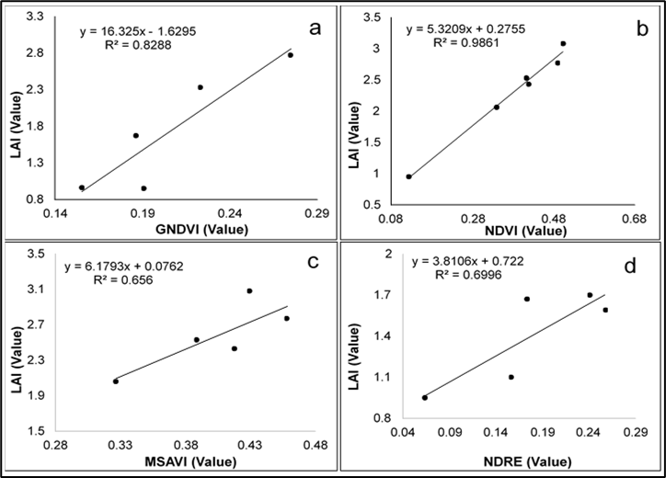
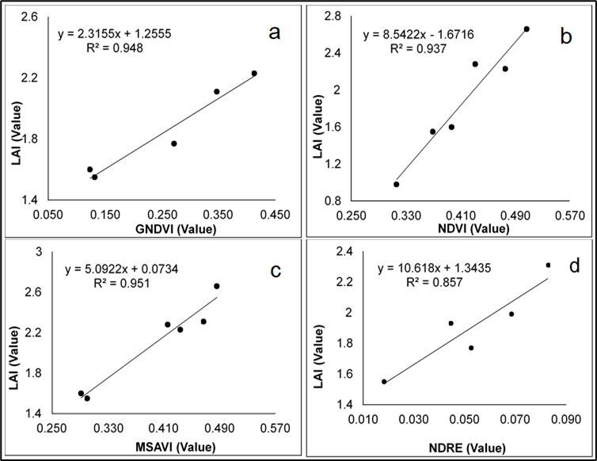
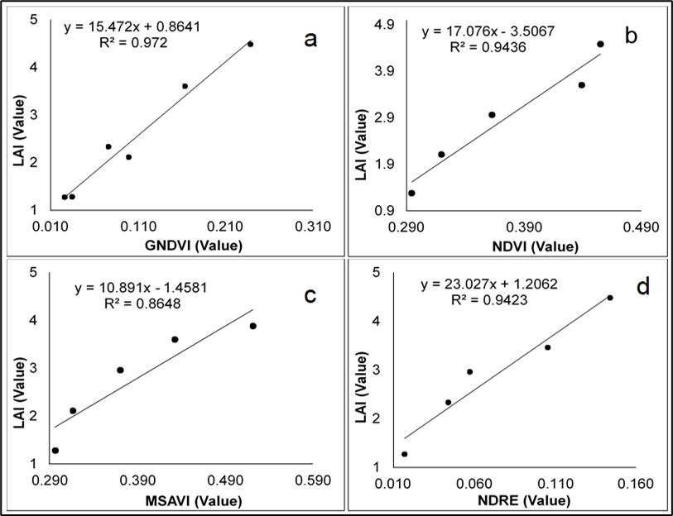
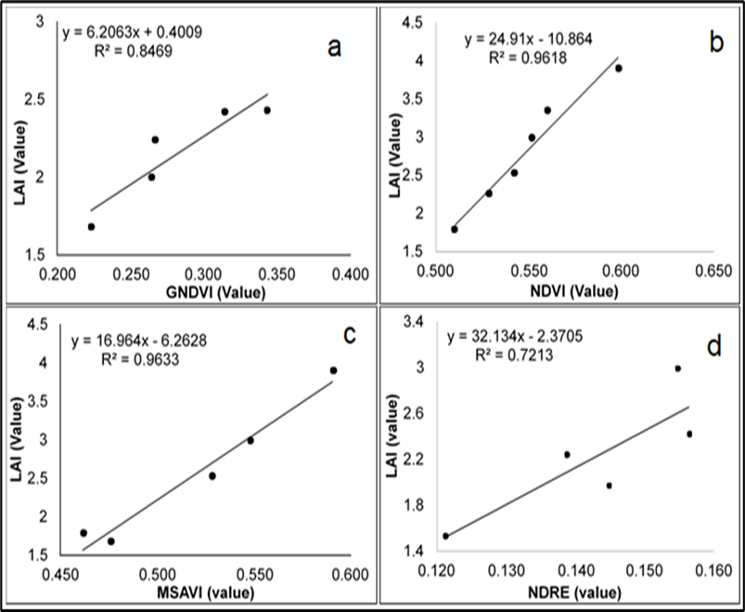
RESULTS (Cont’d) – Integration of UAV vegetation indices with LAI .

Slide 14
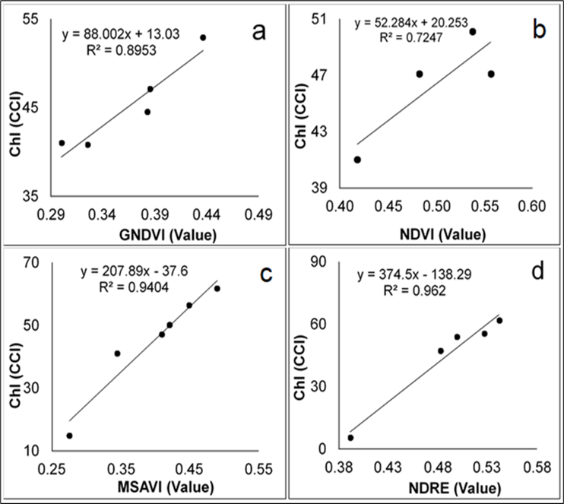
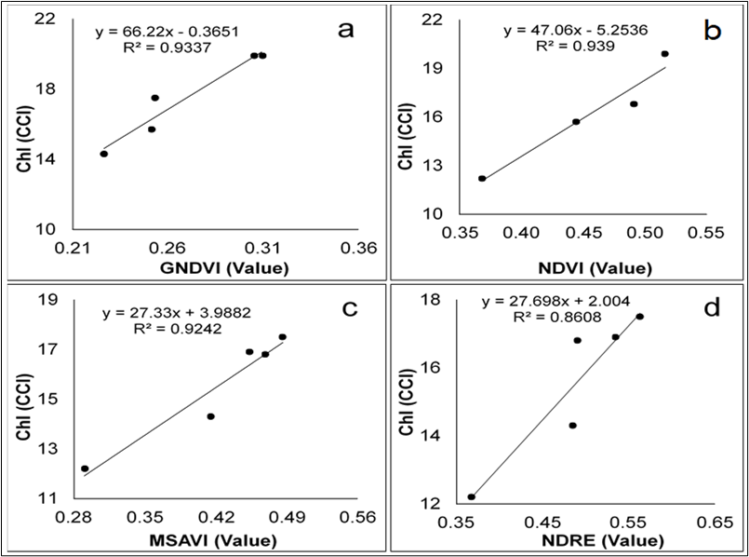
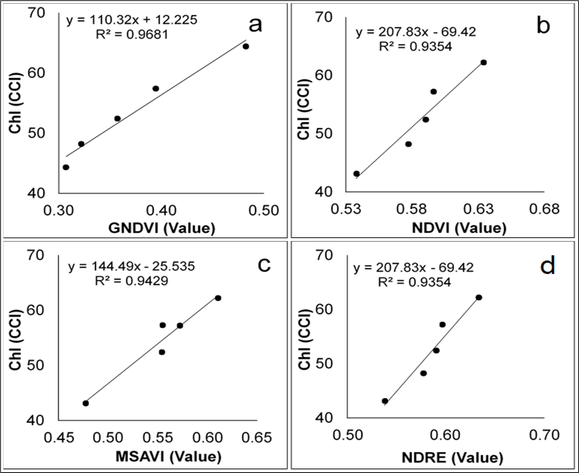
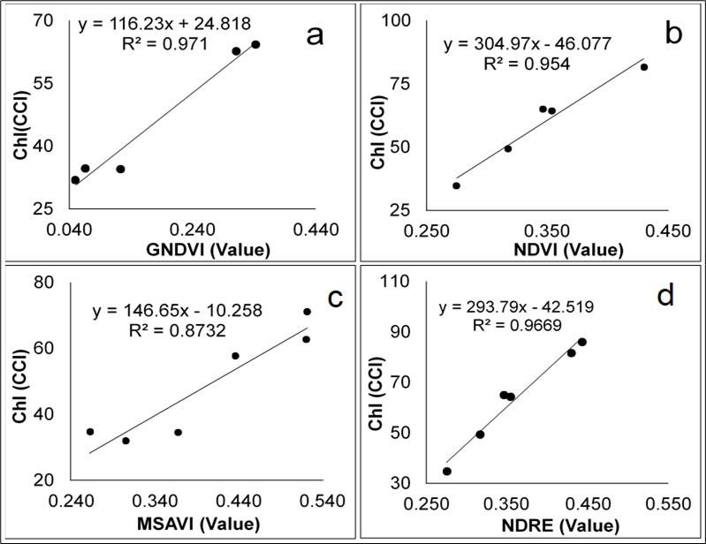
RESULTS (Cont’d) – Integration of UAV vegetation indices with LAI

Slide 15
Discussion and Conclusion
This study noted that UAV imagery can provide reliable information on the spectral signatures of various crop types. The UAV imagery analysis revealed that maize cultivars can be spectrally differentiated from other types of crops based on green and NIR spectral channels.
The field spectrometry analysis of various crops also revealed that maize cultivars can be spectrally differentiated from other types of crops in red, NIR and SWIR spectral wavelengths.
Moreover, this study also demonstrated the ability of the generated spectral indices in characterizing crops when correlated with leaf area index (LAI). Chlorophyll content integrated with GNDVI, NDVI, NDRE, and MSAVI indices computed from UAV multispectral imagery results demonstrated their high ability to further differentiate maize cultivars from other crops.
The study's findings demonstrated the effectiveness of the thresholding technique in selecting ASD data in corresponding to the UAV spectral channels and applying its demarcation, which was done using the minimum and maximum radiance value of the spectral bands identified.

Slide 16
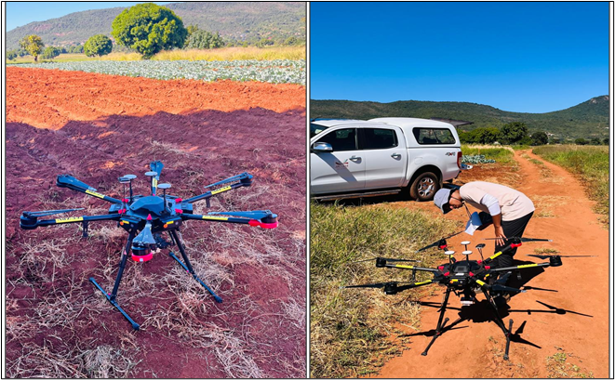
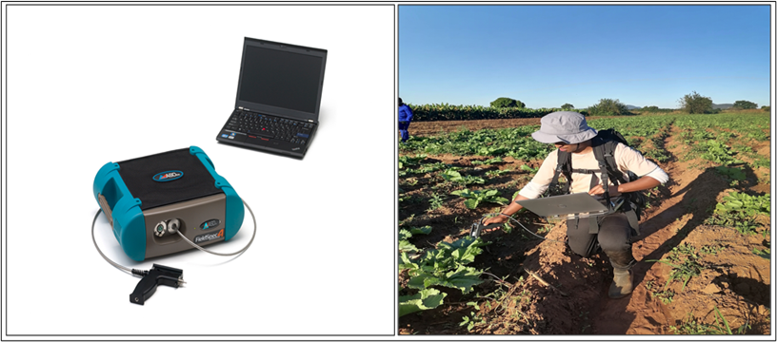
Devices used in the study

Slide 17
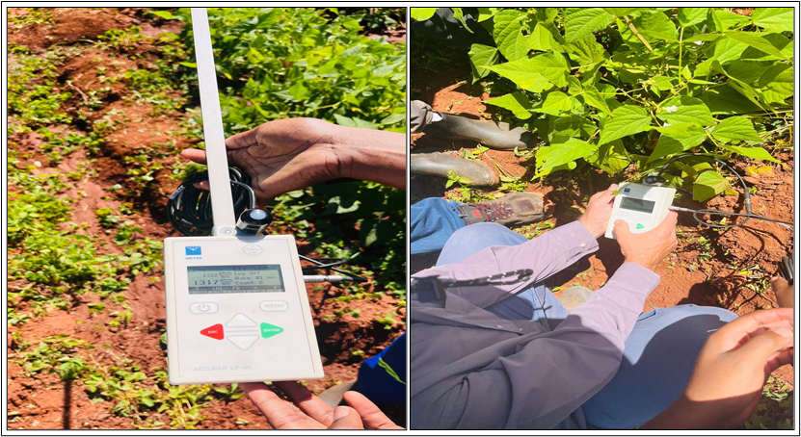
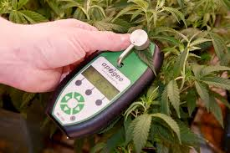
Devices used in the study

Slide 18
References
Ngie, A., Ahmed, F., Abutaleb, K. and Ishimwe, R., 2014, October. Discrimination of maize cultivars using hyperspectral remote sensing. In Proceedings of the 10th International Conference of AARSE (p. 378).
Ray, D.K., Ramankutty, N., Mueller, N.D., West, P.C. and Foley, J.A., 2012. Recent patterns of crop yield growth and stagnation. Nature communications, 3(1), p.1293.
Grote, U., Fasse, A., Nguyen, T.T. and Erenstein, O., 2021. Food security and the dynamics of wheat and maize value chains in Africa and Asia. Frontiers in Sustainable Food Systems, 4, p.617009.
Masters, W.A., 2014. The role of small-scale farms in African agriculture. [Publisher if available].
Baloyi, R.T., 2011. Technical Efficiency in Maize Production by Small-Scale Farmers in Ga-Mothiba, Limpopo Province, South Africa.
Chivasa, W., Mutanga, O. and Biradar, C., 2019. Phenology-based discrimination of maize (Zea mays L.) varieties using multitemporal hyperspectral data. Journal of Applied Remote Sensing, 13(1), pp.017504-017504.
Nakata, M., Sano, I., Mukai, S. and Kokhanovsky, A., 2022. Characterization of wildfire smoke over complex terrain using satellite observations, ground-based observations, and meteorological models. Remote Sensing, 14(10), p.2344.

Slide 19
Thank You!

