Slide 1

Transforming spatial data into value ( through 3D scanning)
Presenter: Chris Kirchhoff
3rd March 2025
Notes:
Who am I
PLS

Slide 2

Who am I
I’m a seasoned land surveyor with over four decades of experience, and have worked from Antarctica to Timbuktu and most countries between.
I’ve been leading my own survey practice for the past 30 years
We specialise in using cutting-edge technologies to tackle spatial challenges, enabling our clients to connect more effectively with the built environment.
I’m passionate about the role of geospatial information as a cornerstone of successful development—it defines the 'where,' which is crucial to complementing the 'what' and 'how' in any infrastructure project."
I am the chairman of the northern provinces Branch of SAGI - The South African Geomatics institute
Notes:
Who am I
PLS

Slide 3
Today I wish to focus more on why 3d data is valuable and why it needs to become a cornerstone of GIS .
The why its needed and its benefits as opposed to the How to ;
Notes:
Who am I
PLS

Slide 4
Data versus information ?
Traditionally, the Geo-Spatial industry has focused on
how we collect and portray data. -Not an easy job.
But as surveying and GIS tools have advanced, the complexity of data collection and description has diminished,
We are learning to be more information-focused.
We are no longer just mapping; we need to be constructing a parallel digital reality—one that doesn't just describe the world but thinks, predicts, and evolves alongside it.
Notes:
Who am I
PLS

Slide 5
Digital twins – the new world ?
In 2-5 years’ time the world will be mapped everyday and artificial intelligence, large language models and machine learning will have been trained to produce daily updated geospatial digital twins of the world.
Notes:
Who am I
PLS

Slide 6
Who uses AI ?
I asked AI to help me think about this presentation
My starting prompt
“Explain the intersection of GIS, 3D spatial information and digital twins –
Be outrageous in your thinking”
Notes:
Who am I
PLS

Slide 7
Who uses AI ?
Its response
“AI-Designed Cities That Self-Construct
In a decade, AI-driven Digital Twins, backed by GIS intelligence, will design and optimize entire cities in minutes. Robots will use these AI-generated plans to construct them without human intervention.
Every tree, road, and transit system will be placed with mathematical precision, balancing traffic flow, carbon emissions, and population density before the first foundation is even laid.
Notes:
Who am I
PLS

Slide 8
The Hyper-Real Parallel Universe for the Built and Natural World
GIS and Digital Twins are converging into something far bigger than just an evolution of mapping or modeling—they are becoming the framework for an entirely new reality.
Forget traditional GIS as a glorified database of maps.
Forget Digital Twins as static, isolated 3D models.
Together, they are birthing a fully sentient, data-driven mirror world—a dynamic, interactive and self-optimizing system that doesn’t just represent reality; it predicts, reacts, and evolves with it.
Notes:
Who am I
PLS

Slide 9
What is a digital twin ?
Digital Twin = Human Twin
Has a body that grows and changes over time.
Has a nervous system ( sensor) that updates in real time.
Real time decision-making based on experience and tactile feedback.
Has a brain that remembers, learns and matures, based on experience.
Notes:
Who am I
PLS

Slide 10
From Static Maps to the Metaphysical Internet of Place
For decades, GIS has told us where things are and their relationships.
Digital Twins tell us how things behave.
But when they merge, we don’t just get a smarter city or a better infrastructure model—we get a living, breathing digital consciousness that connects every tree, building, underground pipe, and atmospheric shift into a single, unified organism.
Notes:
Who am I
PLS

Slide 11
Why the need to use 3D data more !
Traditional GIS has always been a model of limitations
Flat maps ( or some 3 dimensional inputs )
Disconnected datasets
Human-dependent updates
2D or maybe 2.5D data lacks the height, depth, and density required to analyze and predict the spatial complexities of modern infrastructure, environmental systems, and urban planning.
Notes:
Who am I
PLS

Slide 12
Why the need to use 3D data more !
But the real world is volumetric, dynamic, and deeply interconnected.
The transition and further uptake of 3D GIS offers :
Enhanced visualization and improved accuracy
Efficient data management
Advanced analytical capabilities and realistic modeling
Notes:
Who am I
PLS

Slide 13
LiDAR is 3D Spatial Data is GIS’s Missing Dimension
LiDAR ( and the next-gen geospatial sensors ) doesn’t just give us a top-down, generalized surface model; it captures a true, high-resolution 3D reality. It provides:
Bare-earth terrain models without vegetation obstructions
Detailed built environment scans, including facades, overhangs, and substructures
High-density RGB colorized point clouds or meshes that preserve every nuance of geography ( gaussian splatting)
With this, GIS stops being a 2D mapping tool and becomes a real-world simulation engine.
Notes:
Who am I
PLS

Slide 14
How does this happen ?
Treat LiDAR & 3D Spatial Data as the Default Input, not as an Add-On
GIS tools have been designed for flat data, with 3D tacked on as an afterthought.
Every GIS workflow should start with LiDAR-derived 3D spatial data as the foundation and only move to 2D for legacy outputs.
Notes:
Who am I
PLS

Slide 15
How does this happen ?
Integrate GIS, BIM, and IoT into a Real-Time Digital Twin Frameworks
Digital Twins aren’t just 3D models; they need constant real-world updates to provide for real-time, self-updating spatial intelligence :
GIS workflows must merge with : BIM (Building Information Modeling)
IoT sensors
and machine learning.
GIS can then move from passive mapping to active, real-time geospatial monitoring and prediction.
Notes:
Who am I
PLS

Slide 16
How does this happen ?
GIS Practitioners master 3D Geospatial Simulation
The new GIS isn’t just about storing spatial data; it’s about simulating future realities.
GIS workflows need to integrate AI-driven spatial analysis, allowing practitioners to model for example :
Climate resilience scenarios
Urban growth trends
Environmental risks before they happen
Notes:
Who am I
PLS

Slide 17
How does this happen ?
The Shift from “Mapping” to “Predictive Geospatial Intelligence”
We need to stop thinking in terms of maps and start thinking in terms of real-time geospatial ecosystems.
3D GIS powered by LiDAR + IoT + AI will no longer just depict data—it will actively analyze, predict, and recommend actions based on live environmental and infrastructure conditions.
The result? GIS will become the world’s most powerful decision-making tool.
Notes:
Who am I
PLS

Slide 18
Final thoughts :GIS is No Longer a Tool—It’s a Parallel Intelligence
We need to think about how we lead the conversion of geospatial data into a real-time, intelligent system that doesn’t just describe the world—it adapts, predicts, and optimizes it.
3D spatial data is the foundation of a new digital reality.
LiDAR ( and the next-gen geospatial sensors ) is the vision system.
GIS is the brain.
Digital Twins are the body.
Together, they will reshape industries, rebuild cities, and redefine how we interact with the planet itself.
Notes:
Who am I
PLS

Slide 19

How do you obtain this 3D Data such as LiDAR ( and the next-gen geospatial sensors ) ?
Notes:
Who am I
PLS

Slide 20
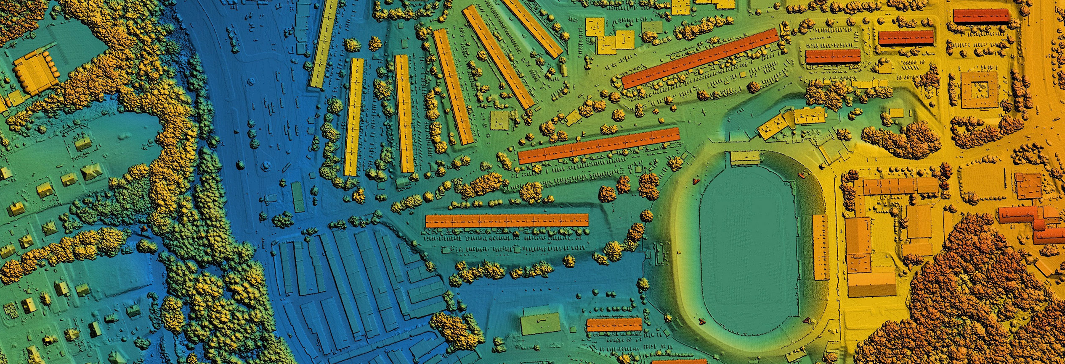

Notes:
Who am I
PLS

Slide 21
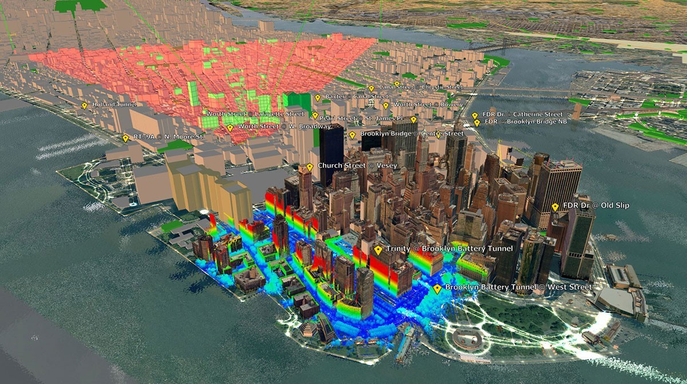
Notes:
Who am I
PLS

Slide 22
Thank you for your time – Any questions ?
Presenter: Chris Kirchhoff
Notes:
Who am I
PLS

