Slide 1

Deep dive into Landcover change in Gauteng:
How to use landcover to extract useful information on environmental change
GISSA - 6 March 2025

Slide 2
Landcover is useful – how useful depends on how you look at it!
“Imagination is more important than knowledge. Knowledge is limited. Imagination circles the world.” – Einstein
Note: No landcover data or change datasets were changed, altered, or harmed in any other way in the processing of this information.
This data should be used as an indicator not necessarily as a measure of change.
Notes:
The dangers of under-appreciating analysts
An excellent analyst is not a shoddy version of the machine learning engineer; their coding style is optimized for speed — on purpose. Nor are they a bad statistician, since they don’t deal at all with uncertainty, they deal with facts. The primary job of the analyst is to say: “Here’s what’s in our data. It’s not my job to talk about what it means, but perhaps it will inspire the decision-maker to pursue the question with a statistician.”
If you overemphasize hiring and rewarding skills in machine learning and statistics, you’ll lose your analysts. Who will help you figure out which problems are worth solving then? You’ll be left with a group of miserable experts who keep being asked to work on useless projects or analytics tasks they didn’t sign up for. Your data will lie around useless.
When in doubt, hire analysts before other roles. Appreciate them and reward them. Encourage them to grow to the heights of their chosen career (and not someone else’s). Of the cast of characters mentioned in this story, the only ones that every business needs are decision-makers and analysts. The others you’ll only be able to use when you know exactly what you need them for. Start with analytics and be proud of your newfound ability to open your eyes to the rich and beautiful information in front of you. Data-driven inspiration is a powerful thing
What Great Data Analysts Do — and Why Every Organization Needs Them - by Cassie Kozyrkov December 04, 2018 Harvard Business review.

Slide 3
Landcover so what!? Seen it before.
Provincial / regional landcover change?
Lets ask some interesting questions
How does landcover change around the borders of reserves and can we use this in reserve management?
What is change is happening in biomes or vegetation units?
How may changes in agricultural use affect food security?
Are protected agricultural areas protecting agriculture?
Can we gain insights to changes in catchments?
What is happening to wetlands?
Can landcover assessment help with landuse planning especially around carbon sinks?

Slide 4
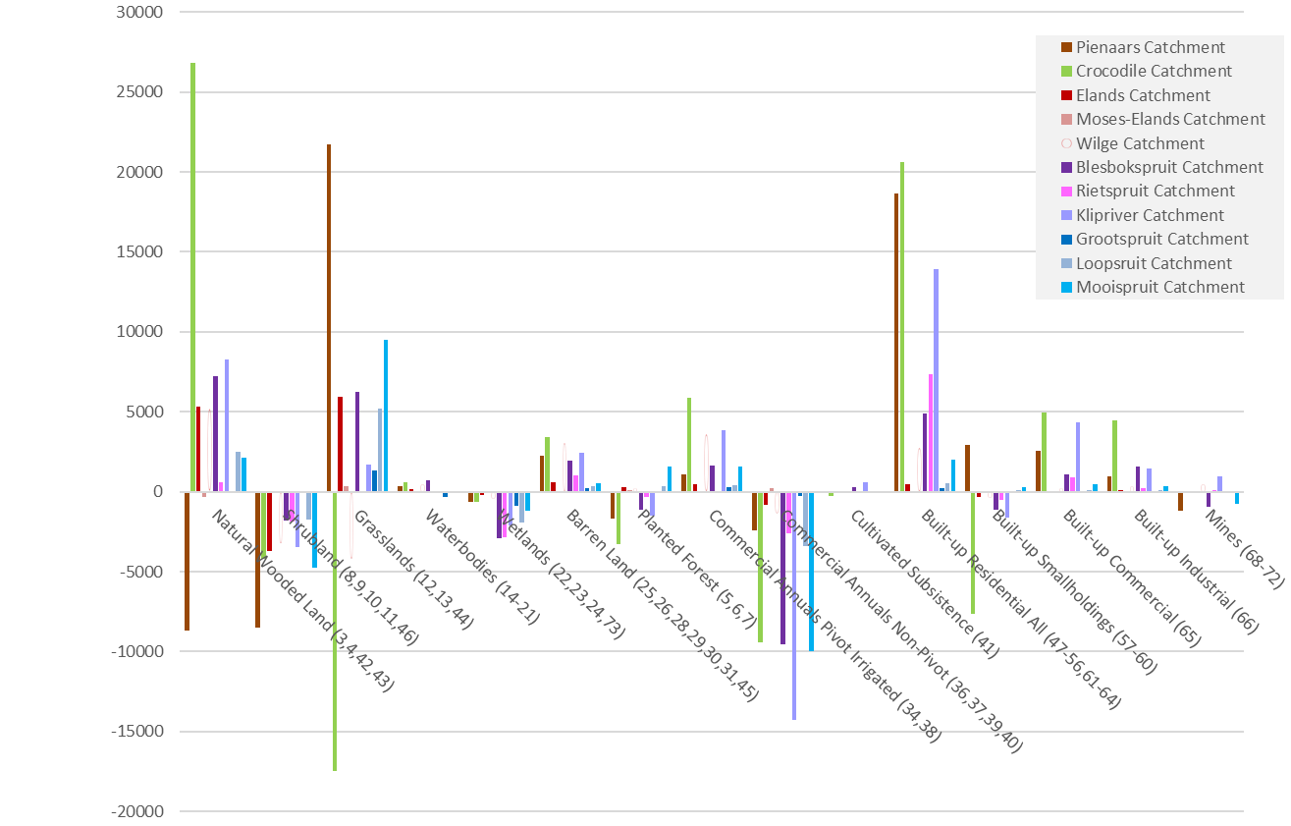
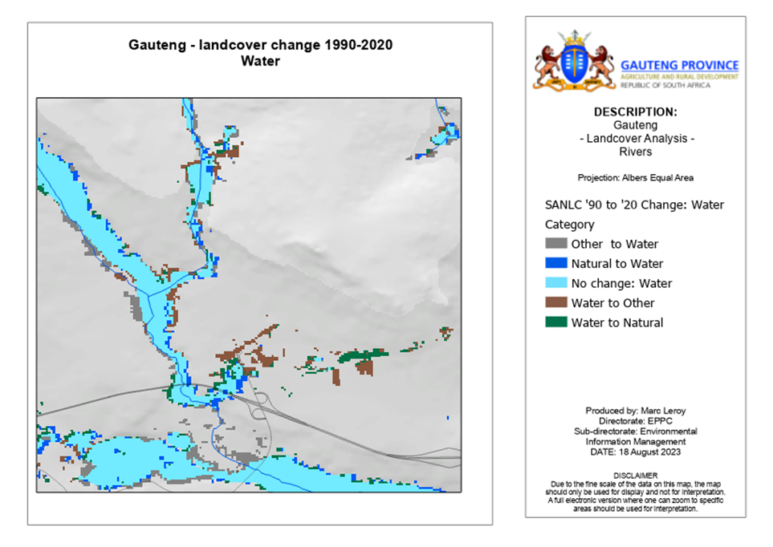
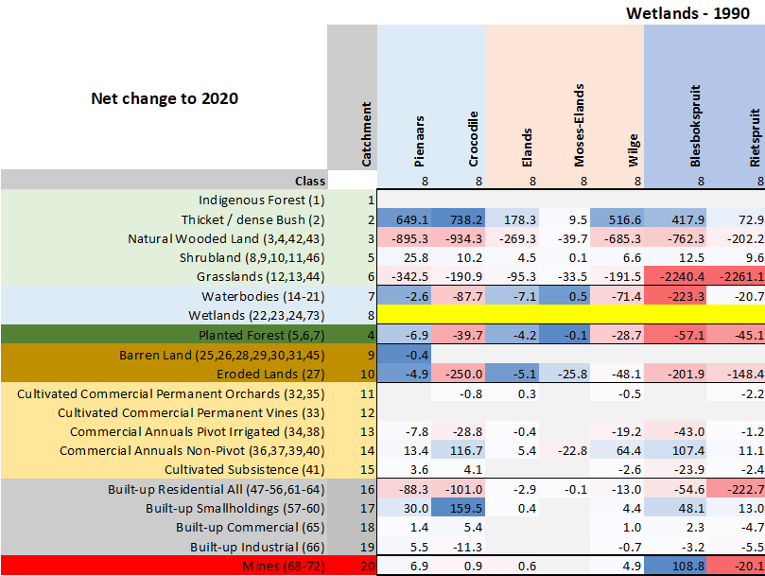
Data mining – patterns of change
How much?
Why?
Where?
Implications?

Slide 5
Background
This project is a result of an initial analysis of landcover change data from DFFE presented at the State of the Environment Information Community of Practice (SEI-COP) meeting 2023.
When looking at the available data from national DFFE at the time, it was noted that the excel tables did not match the provincial area. (This has been resolved).
To look at the change, we used the provincial boundary and the raster change dataset to recreate the excel change matrix for the province for the various change periods.
In doing this we developed a provincial process to look at any time period and spatial extent (municipality, main river catchment and biomes) within Gauteng.
We also defined a schema to look at transformation. This is based broadly on increasing vegetation and soil disturbance / change.
Notes:
Transformation – used loosely to indicate change. Does not have the same context as modification / transformation in the technical guidelines to CBA maps as it does not pertain to ecological condition.

Slide 6
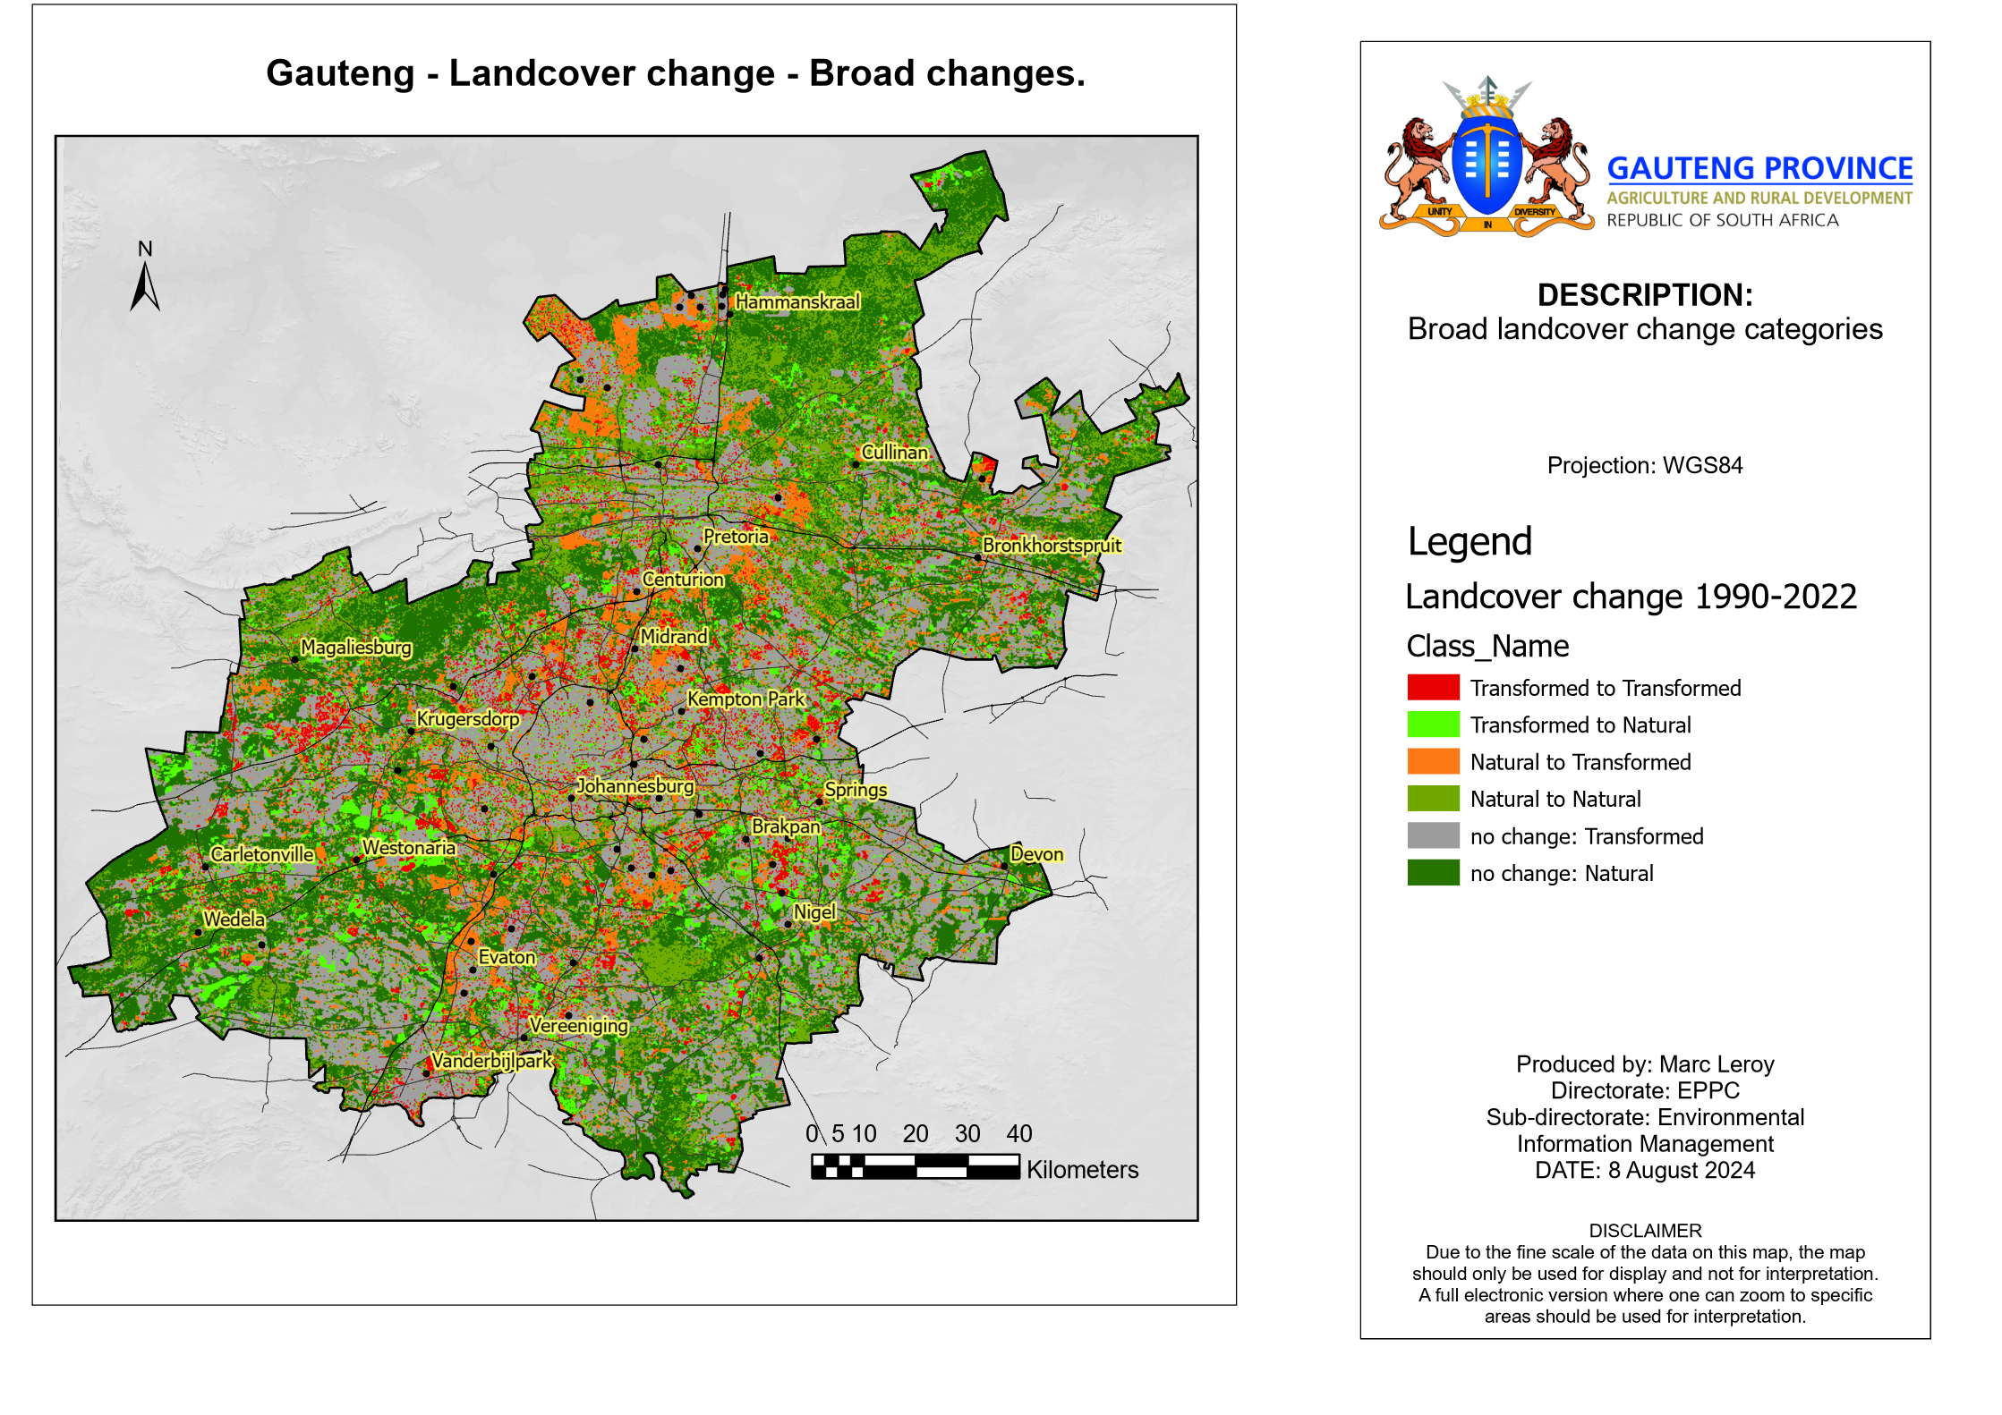
Transformation – Broad Categories
Increasing Transformation
Change category | Change grouping
Barren Land, | Degraded Land | Vegetation change
Eroded Lands,
Planted Forest | Agricultural / Forestry | Vegetation change, soil minimally impacted
Cultivated Commercial Permanent Orchard
Cultivated Commercial Permanent Vines
Commercial Annuals Pivot Irrigated
Commercial Annuals Non-Pivot
Cultivated Subsistence
Built-up Residential All | Urban | Vegetation change, soil impacted
Built-up Smallholdings
Built-up Commercial
Built-up Industrial
Mines | Mines | Potential soil pollution
Notes:
20 landcover classes = 400 change classes = busy map ➔ simplify changes to better visualise and analyse the changes

Slide 7
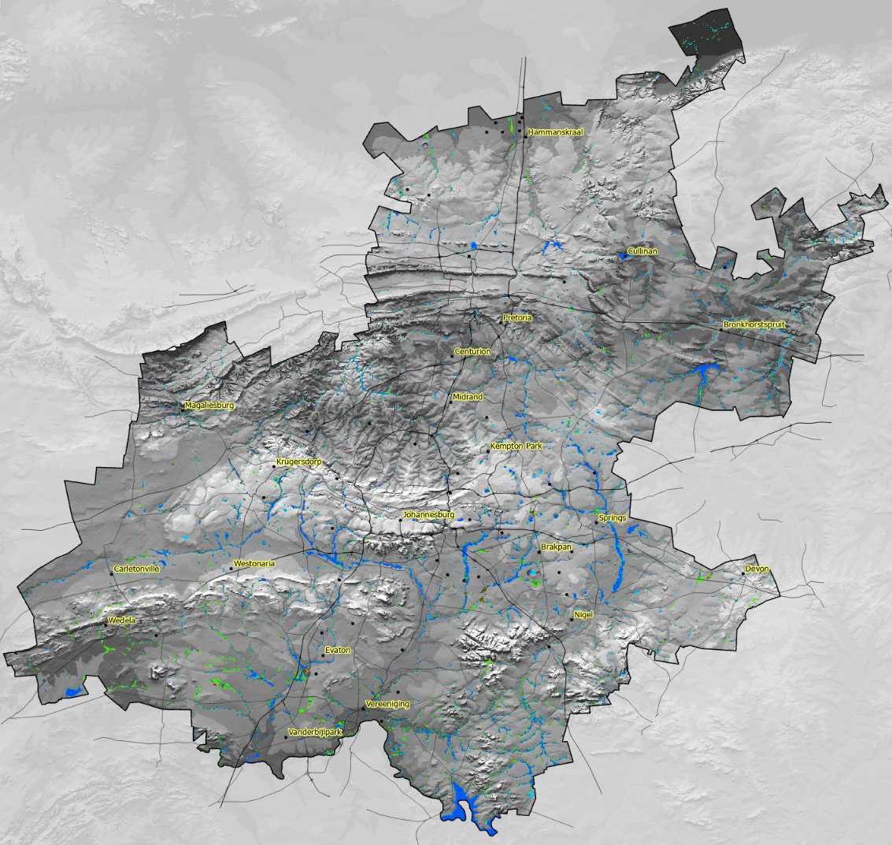
Water
Natural to Water
Water to Natural
Other to Water
Water to Other
No change: Water

Slide 8
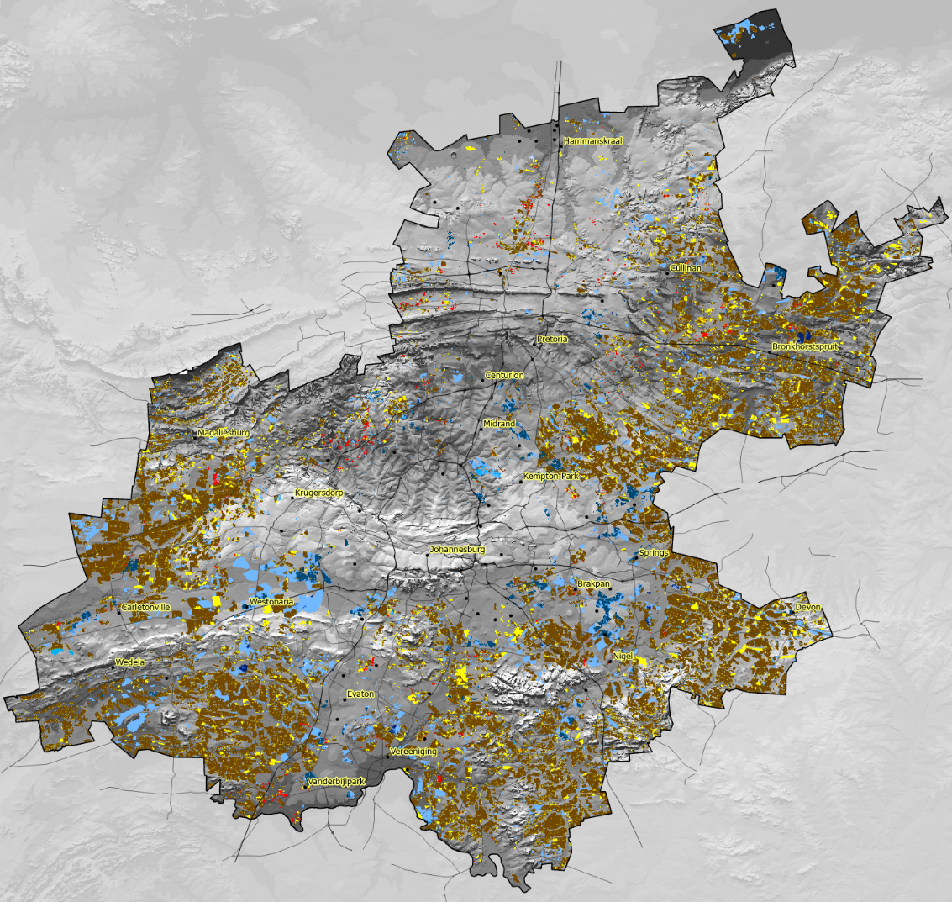
Change in Agricultural classes
Loss of agriculture to “natural” and urban development.
Agricultural land going fallow
No change: Agriculture
Agriculture to Natural
Natural to Agriculture
Agriculture to Forestry
Forestry to Agriculture
Agriculture to Urban
Urban to Agriculture
Agriculture to Mines
Mines to Agriculture
Degraded to Agriculture
Agriculture to Degraded

Slide 9
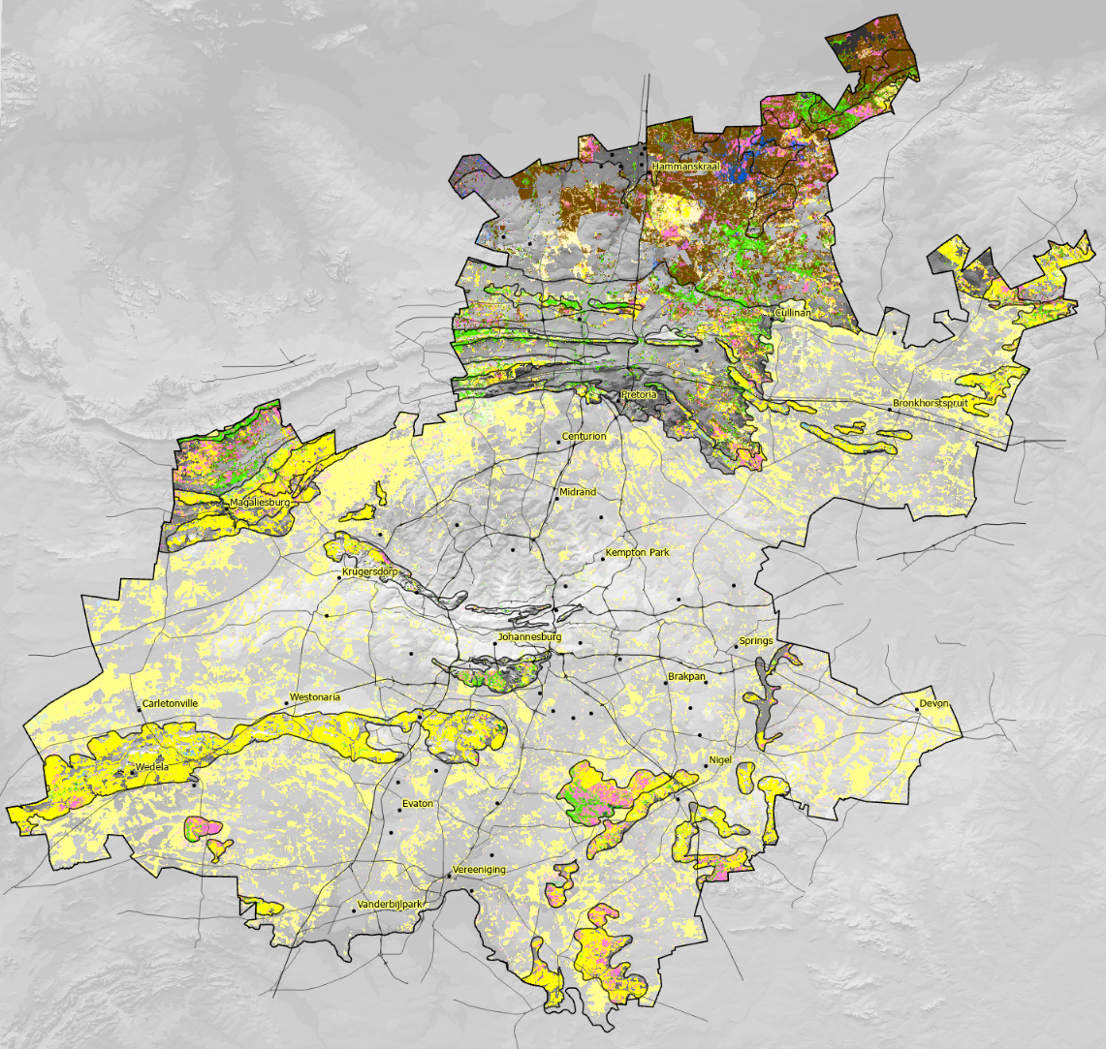
Change in natural classes from 1990-2022 in biomes
Savanna has greater class changes than grasslands.
From | To
grasslands | indigenous forest
grasslands | natural wooded land
grasslands | shrubland
grasslands | thicket / dense bush
indigenous forest | grasslands
indigenous forest | natural wooded land
indigenous forest | shrubland
indigenous forest | thicket / dense bush
natural wooded land | grasslands
natural wooded land | indigenous forest
natural wooded land | shrubland
natural wooded land | thicket / dense bush
shrubland | grasslands
shrubland | indigenous forest
shrubland | natural wooded land
shrubland | thicket / dense bush
thicket / dense bush | grasslands
thicket / dense bush | indigenous forest
thicket / dense bush | natural wooded land
thicket / dense bush | shrubland
grasslands | grasslands
indigenous forest | indigenous forest
natural wooded land | natural wooded land
shrubland | shrubland
thicket / dense bush | thicket / dense bush

Slide 10
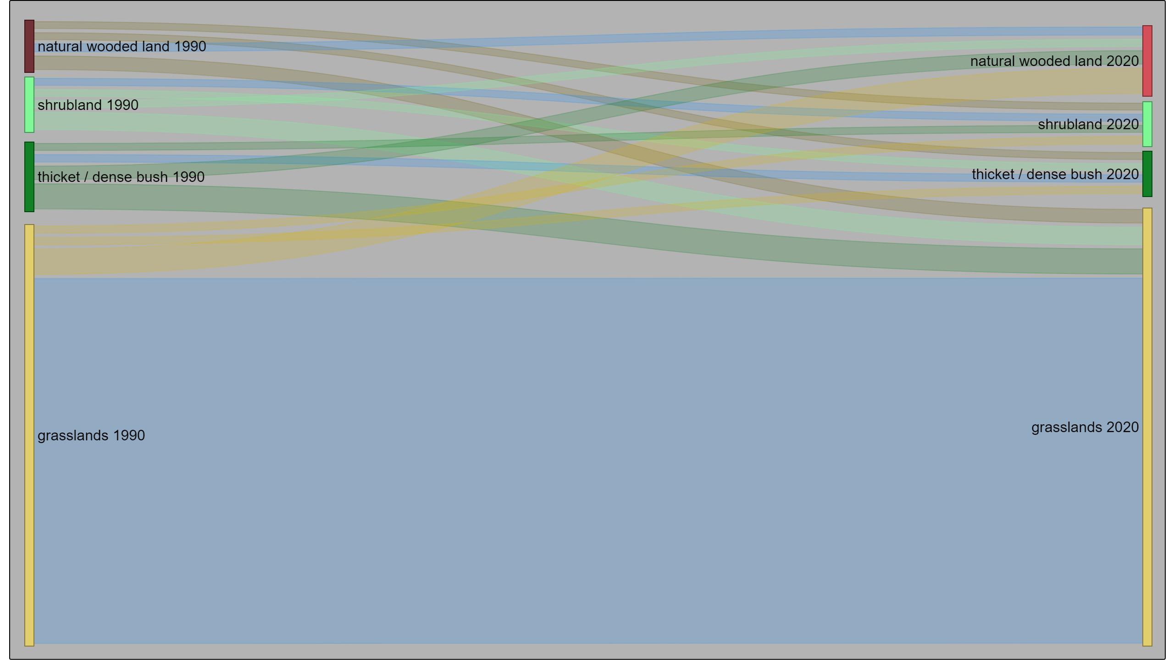
Grassland change (natural classes only)

Slide 11
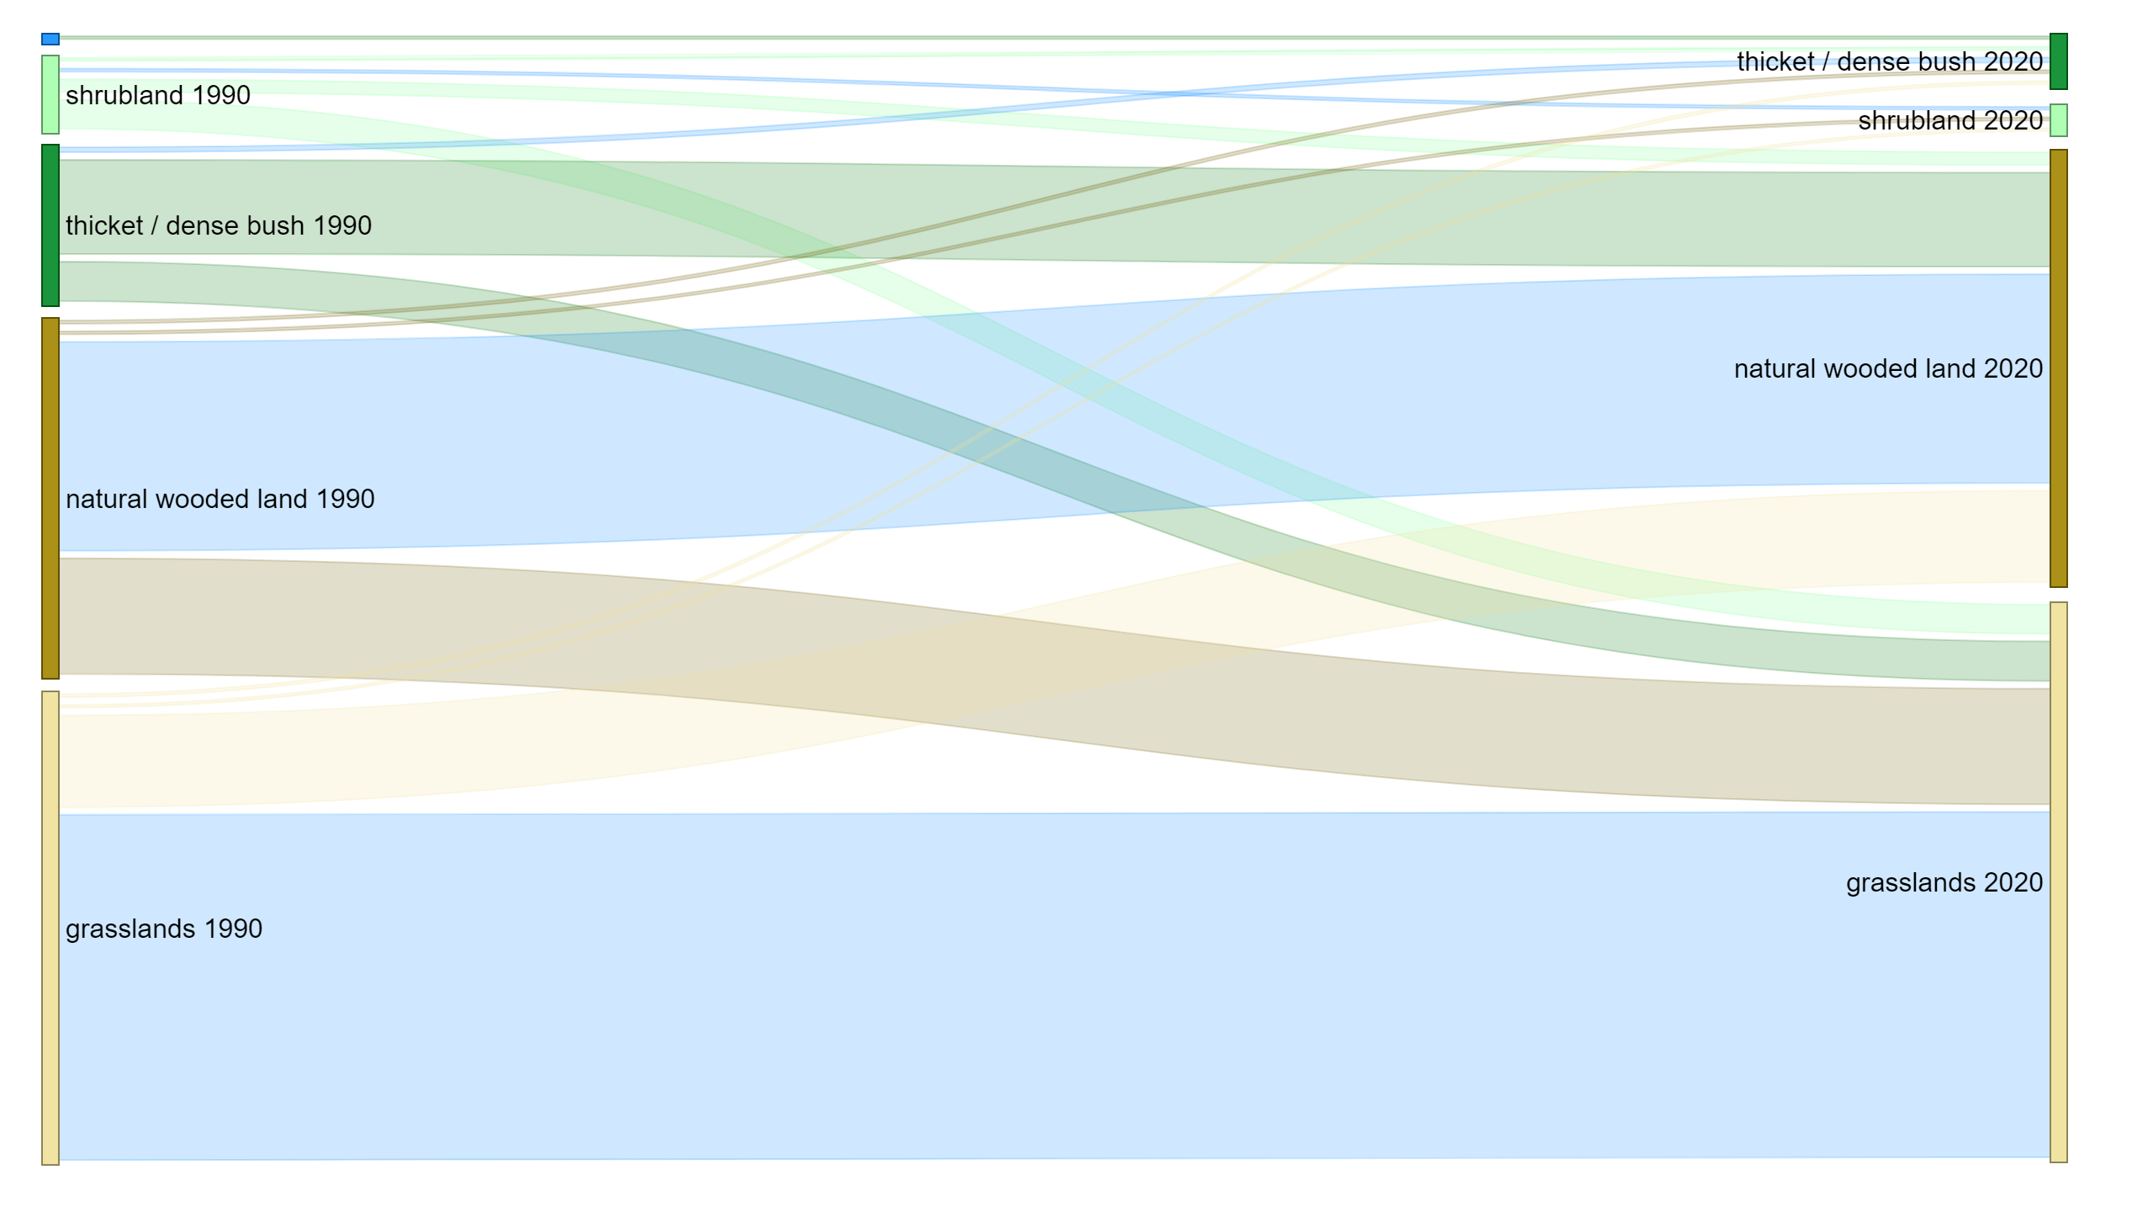
Savanna change (natural classes only)

Slide 12
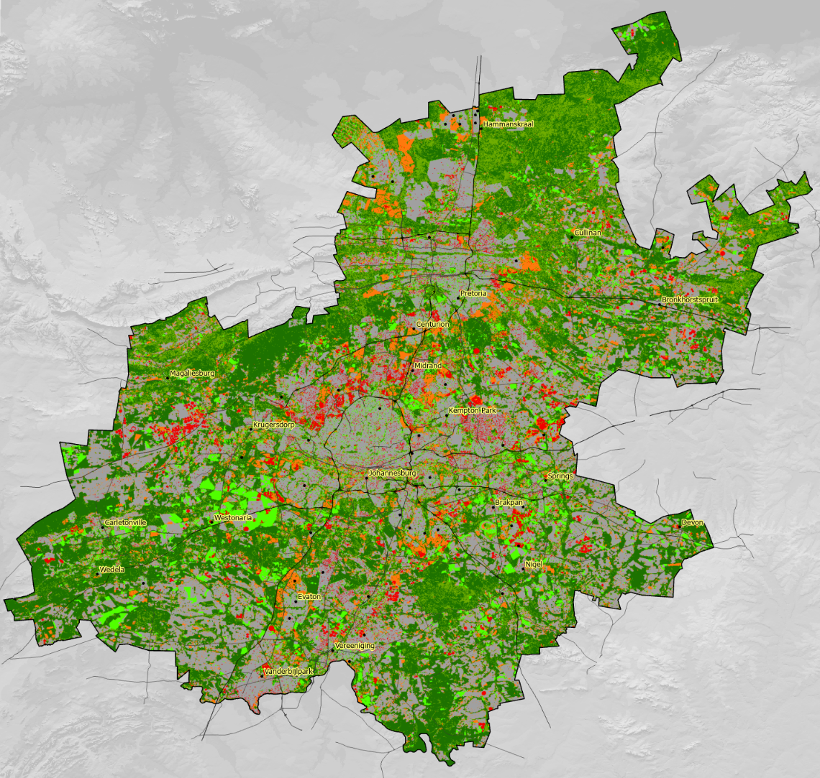
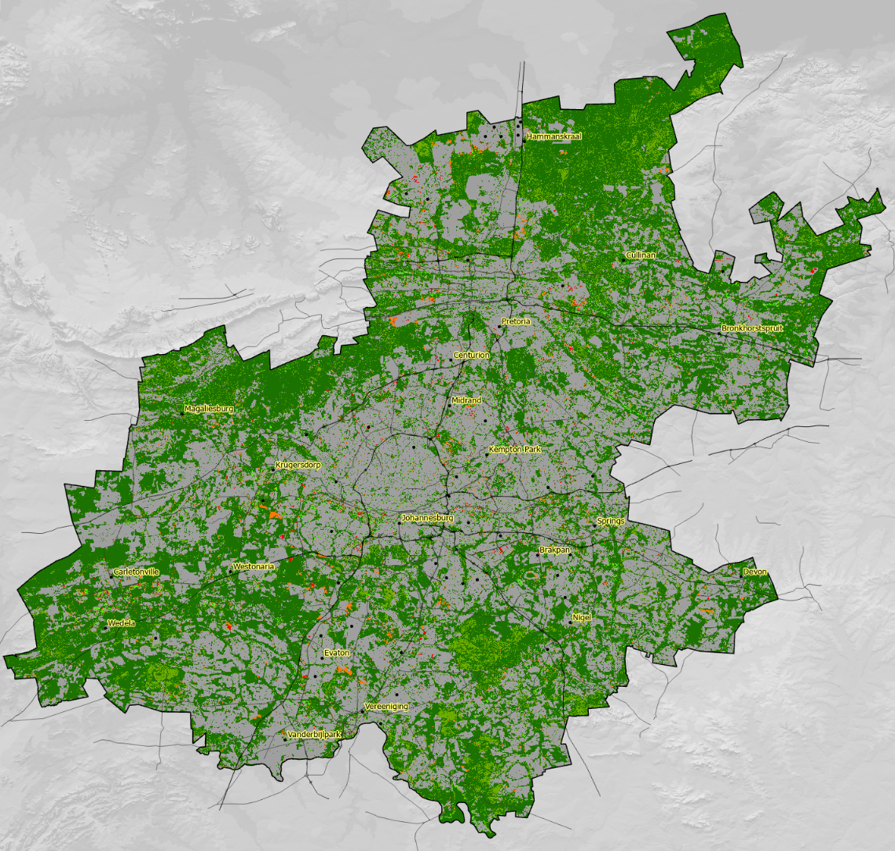
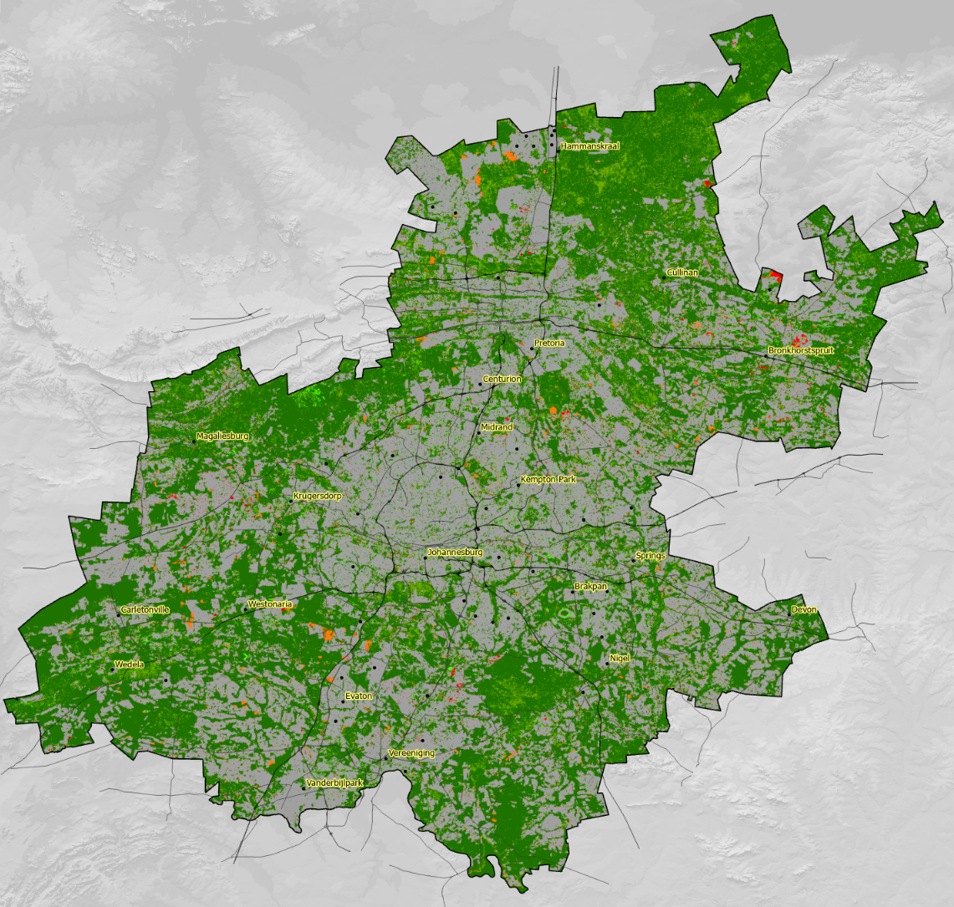
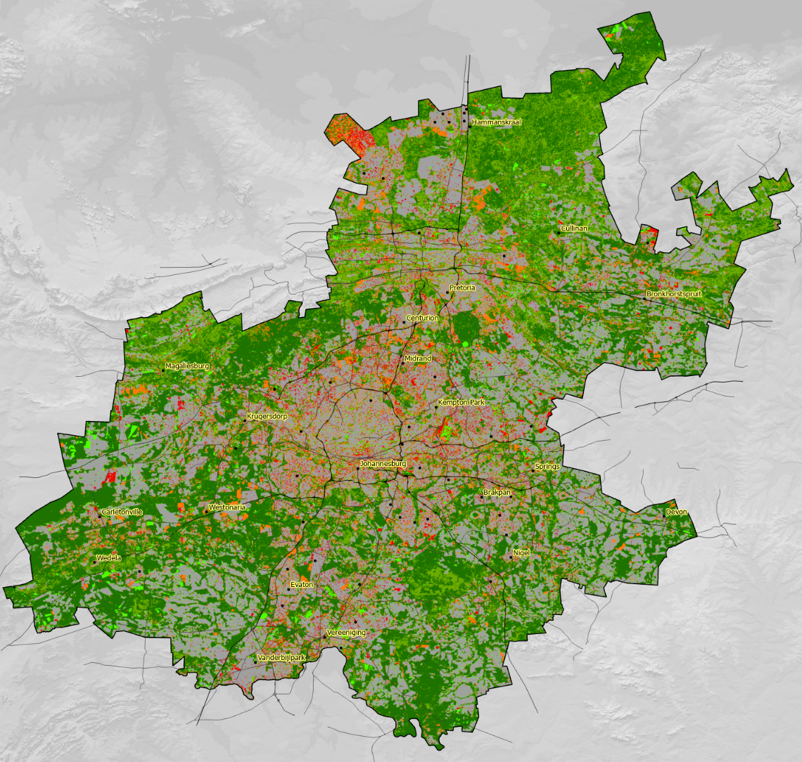

Change to and from natural classes
Key take-home.
Natural in later years may be secondary natural therefore not contribute significantly to biodiversity / ecological processes.
2020-2022
2018-2020
2014-2018
1990-2022

Slide 13
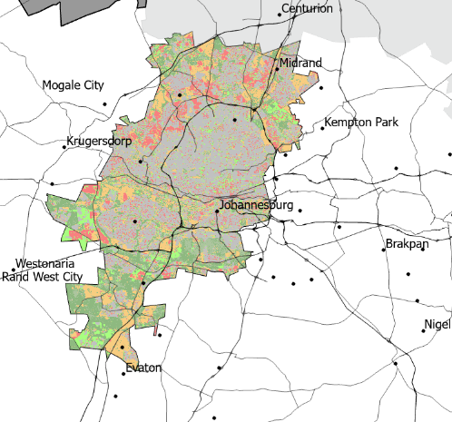
Slice and dice - A look at municipalities and others
Does slice and dice count as harming the landcover dataset?

Slide 14
Matrix setup with schema
Notes:
Red was natural what it changed to – Blue is natural what it was before

Slide 15
Natural Landcover: Gauteng comparison
By including the area of natural land in the latter year that was not previously natural (does not contribute to biodiversity as much), we get a more accurate picture of the loss of natural land
Location | Natural to not Natural | Natural 1990 | % to other | Not Natural to Natural | Natural 2022 | % to natural | % Y-Y change natural | Actual Natural | % difference - Actual | net loss/gain
National | 5167278 | 90050823 | 5.74 | 11616527 | 96964830 | 11.98 | 7.68 | 85348303.56 | 12.0 | -4.30
Limpopo | 597551 | 10691684 | 5.59 | 470071 | 10564204 | 4.45 | -1.19 | 10094133.33 | 4.4 | -5.64
Mpumalanga | 538977 | 5231746 | 10.30 | 401792 | 5094560 | 7.89 | -2.62 | 4692768.12 | 7.9 | -10.51
Gauteng | 197434 | 1019753 | 19.36 | 134579 | 956898 | 14.06 | -6.16 | 822318.21 | 14.1 | -20.23
Free State | 479106 | 8901364 | 5.38 | 380835 | 8803094 | 4.33 | -1.10 | 8422258.32 | 4.3 | -5.43
KwaZulu-Natal | 639006 | 6671729 | 9.58 | 385333 | 6418057 | 6.00 | -3.80 | 6032723.58 | 6.0 | -9.81
Northwest | 320993 | 7760700 | 4.14 | 457975 | 7897682 | 5.80 | 1.77 | 7439706.63 | 5.8 | -4.03
Eastern Cape | 596416 | 13120974 | 4.55 | 1562352 | 14086910 | 11.09 | 7.36 | 12524557.23 | 11.1 | -3.73
Northern Cape | 934448 | 27590055 | 3.39 | 5995633 | 32651241 | 18.36 | 18.34 | 26655607.41 | 18.4 | -0.02
Western Cape | 861043 | 8062607 | 10.68 | 1823160 | 9024724 | 20.20 | 11.93 | 7201563.93 | 20.2 | -8.27
Location |  | Natural 1990 |  |  | Natural 2022 |  | % Y-Y change natural
National |  | 90050823 |  |  | 96964830 |  | 7.68
Limpopo |  | 10691684 |  |  | 10564204 |  | -1.19
Mpumalanga |  | 5231746 |  |  | 5094560 |  | -2.62
Gauteng |  | 1019753 |  |  | 956898 |  | -6.16
Free State |  | 8901364 |  |  | 8803094 |  | -1.10
KwaZulu-Natal |  | 6671729 |  |  | 6418057 |  | -3.80
Northwest |  | 7760700 |  |  | 7897682 |  | 1.77
Eastern Cape |  | 13120974 |  |  | 14086910 |  | 7.36
Northern Cape |  | 27590055 |  |  | 32651241 |  | 18.34
Western Cape |  | 8062607 |  |  | 9024724 |  | 11.93

Slide 16
Context (Where did it go / does it come from)
Looking specifically at percentage change in Gauteng, data from 1990 to 2020.
Different pressures in different municipalities.
The data supports what we inherently know about change.
Location | City of Johannesburg | City of Ekurhuleni | City of Tshwane | Sedibeng District | West Rand District
Natural to not Natural (ha) | 27604 | 25769 | 74994 | 35421 | 30929
% Agriculture | 11.1 | 26.7 | 34.7 | 64.8 | 63.8
% Mines | 4.8 | 7.6 | 2.0 | 1.8 | 6.4
% Urban | 77.1 | 60.8 | 55.5 | 26.2 | 23.7
% degraded land | 7.0 | 4.9 | 7.9 | 7.2 | 6.1
Not Natural to Natural (ha) | 14624 | 20956 | 35285 | 28040 | 34124
% Agriculture | 47.8 | 52.5 | 64.7 | 84.5 | 80.8
% Mines | 5.5 | 15.6 | 8.6 | 4.2 | 9.3
% Urban | 46.6 | 30.7 | 26.4 | 10.6 | 9.2
% degraded land | 0.2 | 1.2 | 0.3 | 0.7 | 0.8
 | 100 | 100 | 100 | 100 | 100

Slide 17
Matrix – derivation of net change
The standard change matrix shows all classes in both years, but…
Thicket changed to grassland and grassland changed to thicket.
What if I want to know the net change (sum)?
 | 1990 National | Indigenous Forest (1) | Thicket / dense Bush (2) | Natural Wooded Land (3,4,42,43) | Shrubland (8,9,10,11,46) | Grasslands (12,13,44)
2020 National |  | 1 | 2 | 3 | 5 | 6
Indigenous Forest (1) | 1 | 0 | 0 | 0 | 0 | 0
Thicket / dense Bush (2) | 2 | 0 | 36 | 3 | 1 | 78
Natural Wooded Land (3,4,42,43) | 3 | 0 | 700 | 80 | 55 | 2100
Shrubland (8,9,10,11,46) | 5 | 0 | 25 | 8 | 14 | 166
Grasslands (12,13,44) | 6 | 0 | 3700 | 837 | 1174 | 26841

Slide 18
Net change / Change vector
By taking the matrix and calculating the change for each linked landcover class the matrix cells stop representing scalar data and now represent vector data (direction and amount of change).
Read from top
Notes:
The previous slides deal with broad categories – here induvial categories are looked at. Columns added down to get net change in the 1990 values.

Slide 19
Net change (% change of municipal area)

Slide 20
Agricultural insights – data comparison
Class in 1990 | City of Tshwane Metropolitan Municipality |  | City of Johannesburg Metropolitan Municipality |  | West-rand District Municipality |  | City of Ekurhuleni Metropolitan Municipality |  | Sedibeng District Municipality
Class in 2020 | Pivot | Non-Pivot | Pivot | Non-Pivot | Pivot | Non-Pivot | Pivot | Non-Pivot | Pivot | Non-Pivot
Indigenous Forest | 0 | 0 | 0 | 0 | 0 | 0 | 0 | 0 | 0 | 0
Thicket / dense Bush | 81 | 1061 | 38 | 146 | 45 | 468 | 22 | 185 | -4 | 465
Natural Wooded Land | 291 | -1423 | 0 | -335 | 5 | -821 | 5 | -568 | -10 | -683
Shrubland | 16 | 527 | 0 | -20 | 99 | 703 | 2 | 10 | 1 | 145
Grasslands | 426 | 443 | 76 | -3311 | 726 | -12833 | 350 | -4436 | 590 | -2427
Waterbodies | 1 | -118 | 0 | -41 | -1 | -60 | 1 | -67 | 1 | -57
Wetlands | 24 | -96 | 0 | -247 | 51 | -256 | 5 | -589 | 80 | 445
Barren Land | 0 | -550 | 0 | -216 | 0 | -178 | -2 | -312 | -10 | -498
Eroded Lands | 0 | 0 | 0 | 0 | 0 | 2 | 0 | 0 | 0 | 0
Planted Forest | 20 | 120 | 2 | -312 | 49 | -468 | 23 | -92 | 10 | -50
Orchards* | 0 | -106 | 0 | 0 | 1 | -50 | -4 | -48 | 0 | 102
Pivot Irrigated* | 0 | -4219 | 0 | -582 | 0 | -5455 | 0 | -1665 | 0 | -3951
Non-Pivot* | 4219 | 0 | 582 | 0 | 5455 | 0 | 1665 | 0 | 3951 | 0
Cultivated Subsistence | 0 | 83 | 0 | -42 | 0 | -17 | -40 | -217 | 0 | 46
Built-up Residential All | -14 | -1880 | 0 | -2011 | 6 | -1168 | -89 | -5739 | 4 | -1502
Built-up Smallholdings | 40 | 2012 | 0 | 173 | 54 | 646 | 1 | 319 | 16 | 1141
Built-up Commercial | -2 | -77 | 0 | -90 | 0 | -40 | -6 | -230 | 0 | -44
Built-up Industrial | 0 | -268 | 0 | -224 | 0 | -180 | -1 | -289 | -56 | -280
Mines | 1 | -843 | 0 | -23 | 1 | -264 | 1 | -285 | 0 | -325
Net gain or loss | 5103 | -5334 | 698 | -7135 | 6490 | -19970 | 1933 | -14023 | 4572 | -7471
1990 areas total (ha) | 1752 | 96531 | 114 | 11704 | 1744 | 111449 | 1140 | 42653 | 2140 | 138431
% change non pivot to Pivot | 241 | -4 | 509 | -5 | 313 | -5 | 146 | -4 | 185 | -3
% change overall | 291 | -6 | 610 | -61 | 372 | -18 | 170 | -33 | 214 | -5

Slide 21
Net change – river catchment comparison
Catchments with the most
urbanisation also have
the most pollution
All catchments lost
wetlands
Notes:
Highlight wetlands and barren land – Move from non-pivot to pivot (water use) – increase in residential (water quantity and quality)

Slide 22

Additional output – flooding / buffers
Rivers show variability at their edges.
Given this variability (up to 6 pixels / 180m) is the 32m buffer around rivers sufficient?

Slide 23
Change vector comparison (Wetlands)
We read the table down from the top: We (lost/gained) wetland class 1990 to classes in 2020
Notes:
Note: Wetlands are not impacted by urbanisation directly. However, urbanisation may reduce the slow release of water out of catchments thus “drying out” wetlands. This supposition would need a scientific assessment of the hydrological changes to verify it.

Slide 24
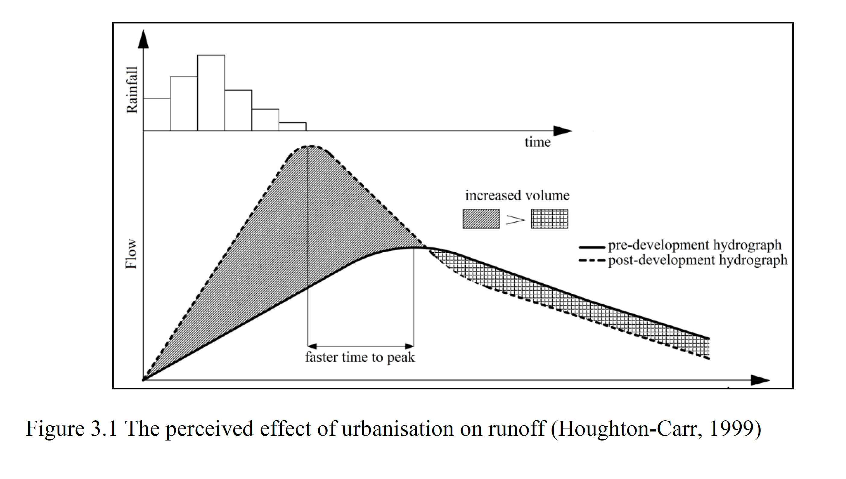
Causes of wetland changes - hydrograph
Faster flood peak = less water retention = wetlands dry out quicker
Faster flood peak = Floods?
Source: Loots & Smithers (2020), WRC Report No. 2747/1/20

Slide 25
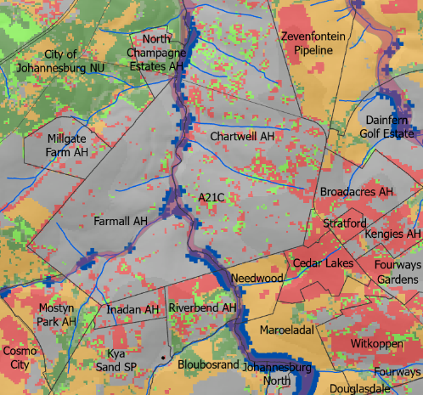
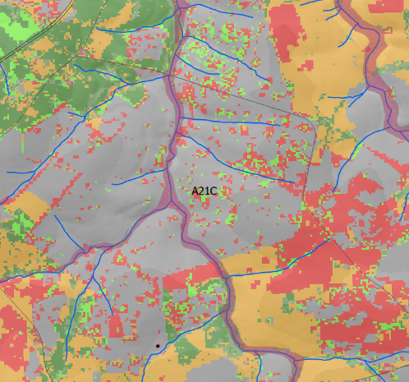
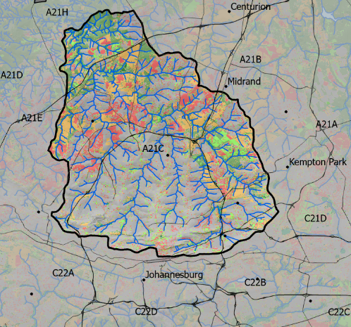
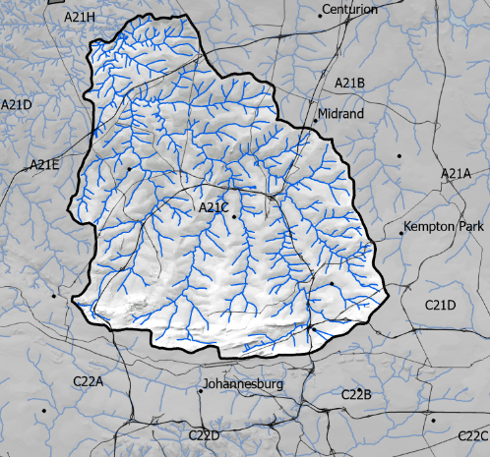
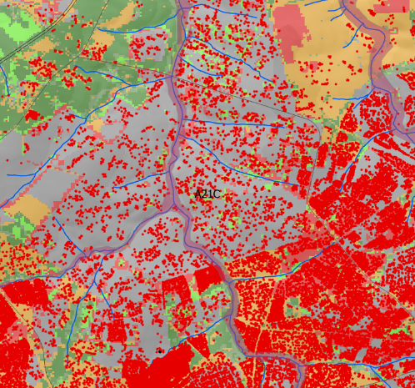
Climate flooding and landcover

Slide 26
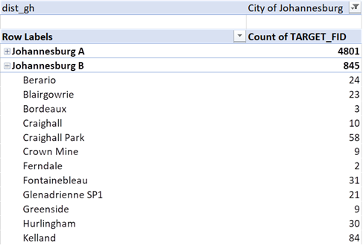
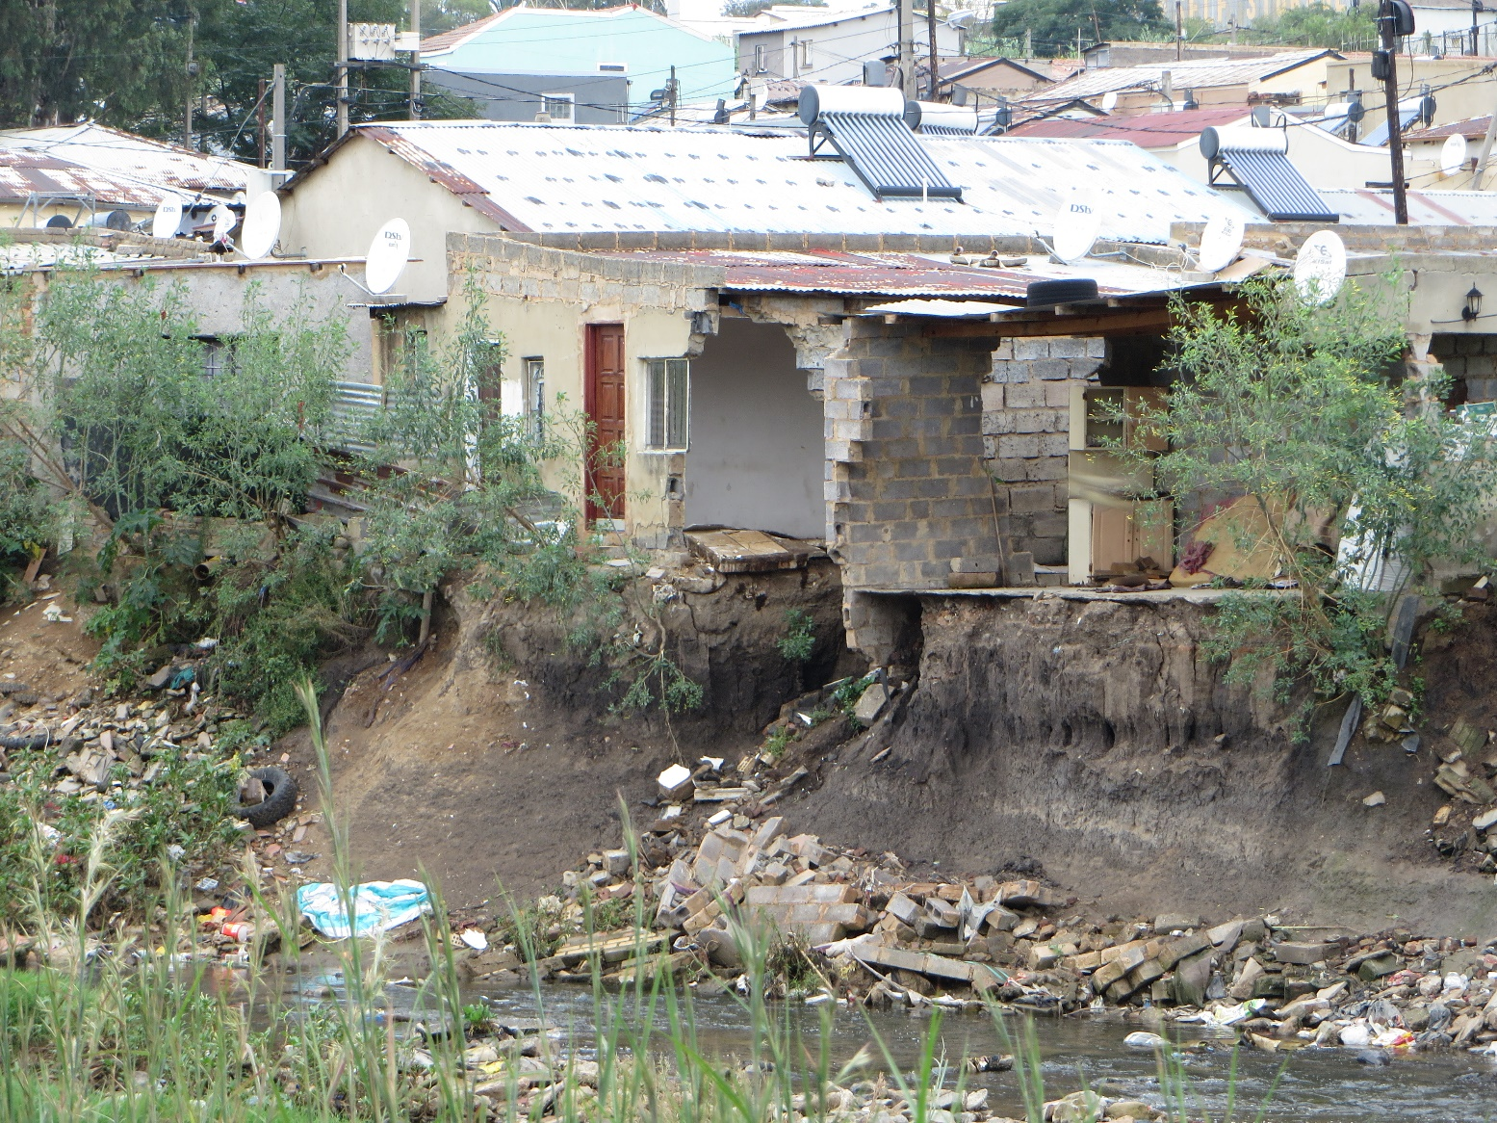
Flood impact potential

Slide 27
Take-home messages.
Is this landcover report and data useful?
  Yes, it is! And its usefulness depends on the depth and breadth to which the data is used.
  It is an indicator we can use to measure progress.
In Gauteng we can now explore the data:
  Spatially, to any area (municipality, catchment, etc) depending on what impact we want to measure and where.
  We have templates (GIS and Excel) along with documented processed to explore future change data.
This data shows the story of landcover change enabling scientists, decision makers and planners measure changes and inform decisions.

Slide 28
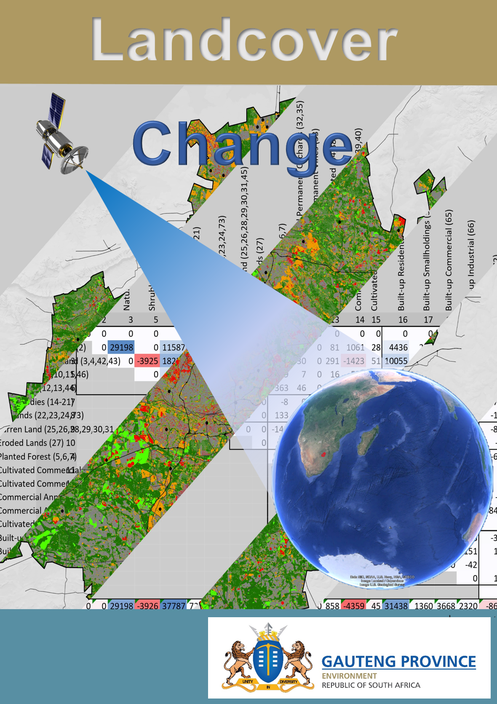
Thank you

