Slide 1


Slide 2
Core Competencies
Data Collection, Capture, and Processing | Database and Spatial Modelling
Map Production | Spatial Analysis
Project Management | Remote Sensing and Photogrammetry
Data Manipulation | Spatial Information Management, Manipulation, and Recovery
Considering the diverse applications of GIS, which three of these SAGC 11 core competencies do you consider the most critical in your sector, and why?

Slide 3
2025 Planning
Based on comments and results:
Meeting dates
6 March In-Person meeting
21 May Hybrid Meeting
20 August Event – In-Person Meeting
29 October Online Meeting
Meetings are to be equally distributed over Gauteng and not solely in Pretoria
Make it more appealing for presenters to present and for members to attend in-person events.
National: Only registered GISSA members attending meetings will be submitted to SAGC for CPD points.

Slide 4


Slide 5

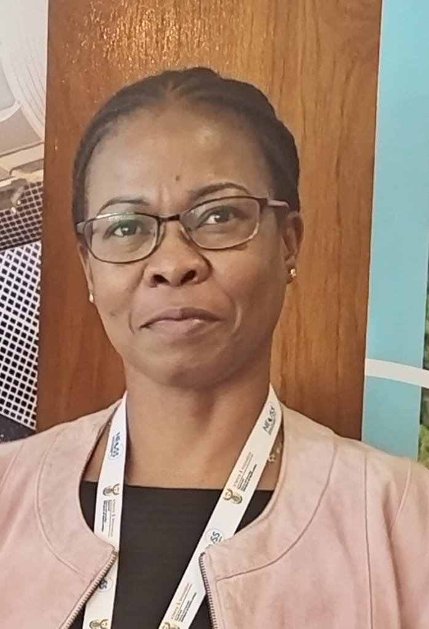






GISSA GAUTENG COMMITTEE MEMBERS 2025
Audrey Mbatha
Pieter Otto
Samy Katumba
Laurette Coetzee
Thiasha Vythilingam
Danie Jooste
Antonie Peens

Slide 6






LinkedIn posts
Social Media
Notes:
ICC conference where GISSA was a sponsor and attendee.
The event was an ideal melting pot of organizations to share their insights in the field but also to broaden their own knowledge.
The event drew presenters from across the country and from abroad.

Slide 7


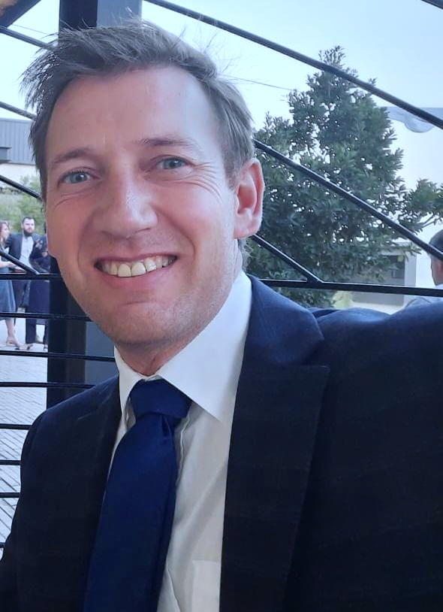



National Website Management
Notes:
ICC conference where GISSA was a sponsor and attendee.
The event was an ideal melting pot of organizations to share their insights in the field but also to broaden their own knowledge.
The event drew presenters from across the country and from abroad.

Slide 8


Slide 9
National Financial Report
6 March 2025
Manie

Slide 10
Region | Membership October 2023 | Membership November 2024 | change
EC | 32 | 30 | -2
WC | 143 | 138 | -5
GP | 220 | 229 | 9
KZN | 55 | 49 | -6
FS | 8 | 10 | 2
LP | 16 | 20 | 4
MP | 31 | 23 | -8
NC | 2 | 2 | 0
Int | 4 | 1 | -3
NW | 11 | 9 | -2
 | 522 | 511 | -11

Slide 11
Region | Membership November 2024 | Membership March 2025
EC | 30 | 30
WC | 138 | 155
GP | 229 | 243
KZN | 49 | 51
FS | 10 | 11
LP | 20 | 20
MP | 23 | 29
NC | 2 | 1
Int | 1 | 2
NW | 9 | 12
 | 511 | 554*

Slide 12
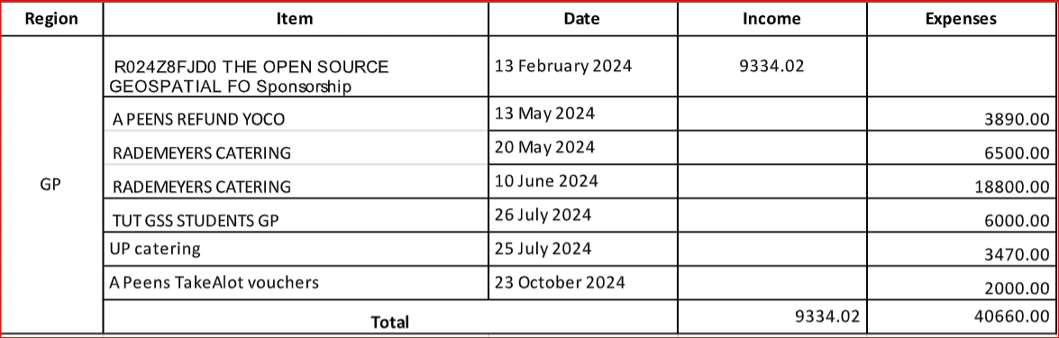
National Secretariat Report
6 March 2025

Slide 13
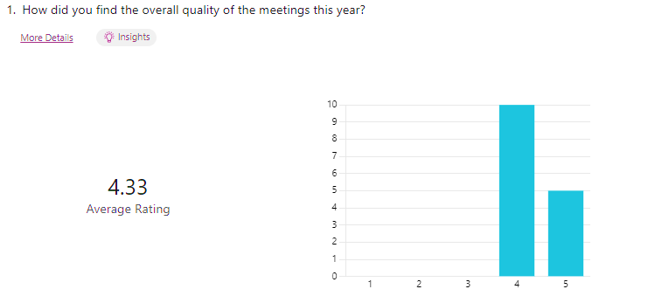

Slide 14
Acknowledgments
Thank you to all the presenters – token of appreciation.
Juniper systems and Esri for hosting the event
Danie for making the name badges for everyone. Thanks to all the committee members!
Special thank you to all panelists and Lauren – token of appreciation

Slide 15
Closing – Questions and Suggestions
Please return all name badges to the box at the door.
Closing questions or suggestions from the audience – How do you feel about moving away from a solely presentation orientated GISSA meetings?
Should you require any further information (CVs from candidates etc.), please do not hesitate to mail me (Antonie)
Thank you everyone for joining, drive safe and looking forward to seeing everyone at the next event.

