Slide 1
DRAFT NATIONAL SPATIAL DEVELOPMENT FRAMEWORK NSDF OVERVIEW AND UPDATE
28 FEBRUARY 2020
GISSA Forum
Presenter: Sheena Satikge-Sibisi

Slide 2
PRESENTATION STRUCTURE
01
02
03
04
05
06
NSDF Update & Way Forward
Introducing the NSDF,
Process
Interrelated Shifts, Vision
National Spatial Development Levers
National Spatial
Action Areas
NSDF Summary

Slide 3
1. INTRODUCING THE NSDF
INTRODUCTION & MANDATE
Chpt 8 of the NDP calls for preparation of a ‘National Spatial Development Framework’ (to be reviewed - 5yrs)
Sections 5(3)(a), 13(1) and (2) of SPLUMA mandate the Minister to “after consultation with other organs of state and with the public, compile and publish an NSDF”
In accordance with SPLUMA the NSDF must within the broader ‘family’ of strategic and sector plans of government:
Target and direct all infrastructure investment and development spending decisions by national sector departments and State-Owned Entities
Guide and align plan preparation, budgeting and implementation across spheres and between sectors of government
Frame and coordinate provincial, regional and municipal Spatial Development Frameworks
PURPOSE OF THE NSDF
Support national development priorities (as articulated in the NDP);
Provide strategic, integrating and coordinating guidance to (1) national sector planning;
Pave the way and prepare the ground for national spatial planning as an ongoing activity by bringing about change in national spatial governance and the structures required for this function in government;
Galvanise State action (investment and spending) on a set of national spatial development priorities; and
Introduce sub-national spatial development planning in the form of ‘functional development regions’.

Slide 4
2. NSDF DEVELOPMENT AND ENGAGEMENT PROCESS
Phase 1:
Preparatory
NSDF Concept Report
2015
TWG: Research Support
TWG: Process and issues
NPC: Process and issues
Expert interviews
Practitioners’ survey
TWG: Challenges, vision, concepts, implementation
Bi-lateral sector engagements
TWG: Emerging draft NSDF components
Bi-Lateral sector engagements
Joint provincial workshop
Draft NSDF
7 Thematic Research Reports & Consolidated Research Report, 2016
NPC: Draft NSDF
TWG: Draft NSDF
Individual provincial (including municipal) engagements
Continued bi-lateral sector engagements
NSDF Indaba, 2019
SPLUMA process & draft Cabinet process. Gazette notice, 2020.
Phase 2:
Research/Investigative
Consolidated Discussion Document: Towards Draft NSDF, 2018
N
S
D
F
Phase 3:
Spatial Analysis & Proposals
Phase 4:
Draft NSDF Phase
Phase 5:
Cabinet Approval

Slide 5
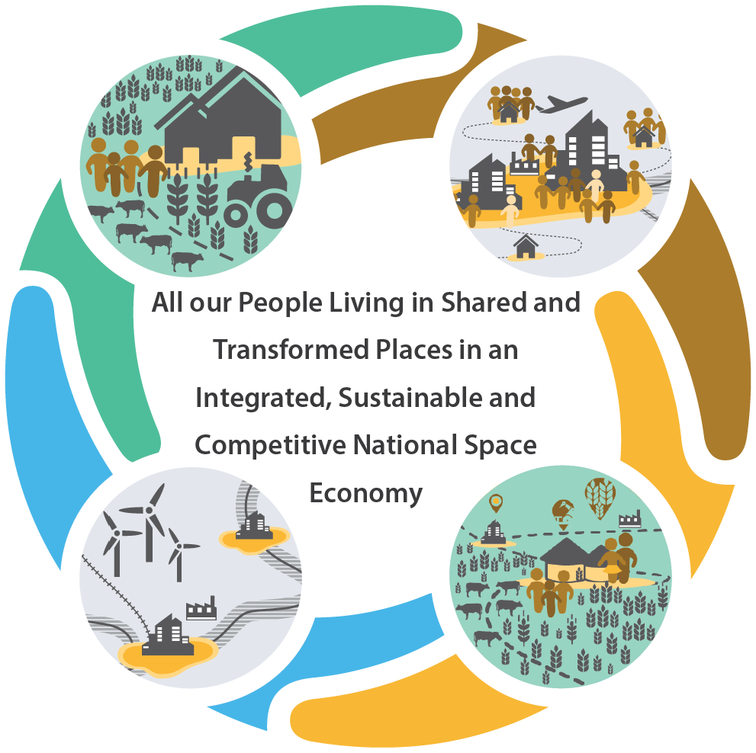
3. NSDF VISION 2050
Notes:
Mission:
Making our Common Desired Spatial Future Together Through Better Planning, Investment, Delivery and Monitoring

Slide 6
4. INTERRELATED SHIFTS
Based on the NDP and SPLUMA as guides and drivers, five interrelated shifts in the National Spatial Development Logic are proposed by the NSDF to ensure the movement to a truly Post-Apartheid Spatial Development Pattern. These shifts must take place with regards to:
The Beneficiaries of National Spatial Planning and Spatial Development – from the few to the many, equal socio-eco land-use, amenities access;
Our Natural Resource Base – quantification, protection, value distinction;
The Nature, Function and Performance of Our Settlements – activation of growth opportunities, polycentric, diverse economy;
Our Rural Areas - regional-rural systems, intra exchanges, anchors;
The Nature, Significance, Form and Impact of Spatial Development Planning - coordination, integration, collaboration, outcome-based planning, M&E of spending. importance of geo-spatial referencing in identifying where projects are located promotes better accountability.
Notes:
Beneficiaries
Placing the interests and benefit of ‘the many’ at centre stage, and not those of ‘a/the few’, by ensuring access for all to the use of land for residential, social, economic and cultural purposes, both in urban and in rural areas
Natural Resource Base
Creating a far greater awareness on our natural resource base and its quantification (GIS will play an important role), to enhance the sustainable use and protection of our critical natural resources
Making a clearer distinction between the ecological and economic value of natural resources, and pursuing a far greater interest in understanding of future trends and risks in natural resource use
Urban Areas
Urban areas as engines and drivers of radical transformation at scale, unleashing the enormous growth opportunities – diversify and expand the economy to other sectors
Pursuing a denser, smaller, polycentric system of settlements that has (1) a smaller footprint, and (2) spans urban and rural areas
Emphasising need to develop a new kind of city: hub for knowledge-creation, learning and innovation, culture, entertainment, tourism, in which public space can become a key driver of a new ‘people’s economy from below’
Our Rural Areas
Recognising the need to develop and strengthen regional-rural systems in the pursuit of vibrant, inclusive and sustainable rural development through the development of regional development anchors, rural edges, intra-regional rural trade and economic diversification
(1) connect urban to rural areas in mutually-beneficial ways, (2) act as catalysts for regional-rural development, and (3) develop a polycentric network of smaller rural service towns to ensure public service provision, local economic development and far greater levels of rural-to-rural social and economic interaction and social cohesion.
Spatial Development Planning
Ensuring greater coordination, integration and collaboration in spatial development planning in and between the spheres and sectors of government, including the use of
(1) spatial targeting, and (2) differentiated responses. (3) outcome-based planning – monitoring of the impact of national spending
Introducing a ‘spatial transformation accountability system’

Slide 7
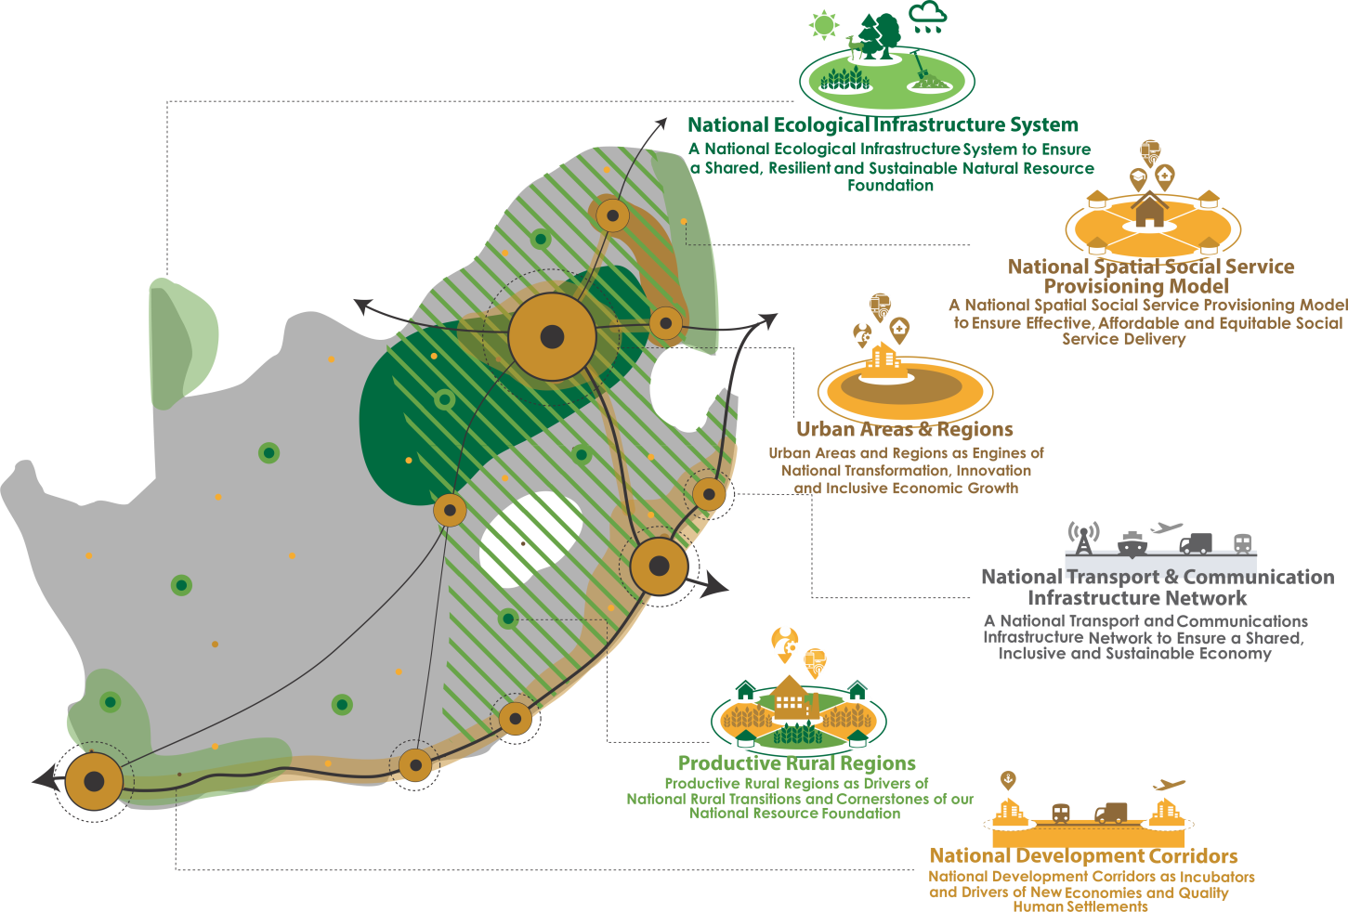
5. NATIONAL SPATIAL DEVELOPMENT LEVERS
To give spatial expression to the NSDF vision, support shifts that need to be made, six national spatial development levers.
Urban Areas and Regions - as engines of National Transformation, Innovation and Inclusive Economic Growth;
National Development Corridors - as incubators and drivers of New Economic and Quality Human Settlements;
Productive Rural Regions - as drivers of rural transitions and cornerstone of our national resource foundation;
National Ecological Infrastructure System - to ensure a shared resilient and sustainable natural resource foundation;
National Transport & Communication Infrastructure Network to ensure a shared, inclusive and sustainable economy;
National Spatial Social Service Provisioning Model - to ensure effective, affordable and equitable social service delivery.
Notes:
Concepts based on:
The contextual realities, challenges and opportunities.
The drivers, levers and principles as set out in the NDP, the IUDF and SPLUMA
What is considered ‘good spatial and settlement planning’ in locally, international planning policy frameworks, guidelines and practice; trends, flows and pattern that shape our landscape and development goals.
Theory of spatial development planning, urban design, regional and rural development planning, institutional economics, agglomeration economics, and ecological resource planning and management.
Urban Areas and Regions - Engines of National Transformation, Innovation and Inclusive Economic Growth
National Spatial Development Corridors - Incubators and Drivers of New Economies and Quality Human Settlements
Productive Rural Regions - Drivers of National Rural Transitions and Cornerstones of our National Resource Foundation (Regional-Rural Development Model polycentric functional rural regions - at least one well-connected regional development anchor, both within the region on the national transport network to ‘anchor’ the region in the national space economy – enhanced rural-rural trade, RDPs – IDP, Land Reform)
A National Spatial Social Service Provisioning Model - Ensure Effective, Affordable and Equitable Social Service Delivery – Appropriate and Equitable investment and placement of social services – CSIR GUIDELINES FOR THE PROVISION OF SOCIAL FACILITIES IN SOUTH AFRICAN SETTLEMENTS
(rational allocation of facilities rendering social services to be done in national space. In addition to this, investment in social infrastructure, if (1) planned well, (2) designed for multiple uses, and (3) placed in ‘the right location/spot’, e.g. on public transport routes, and in a place where adequate municipal services are available) National urban Core – Regional Development Anchors – Rural Service Centres – Other Settlements hierarchy of service provision
National Ecological Infrastructure System - Ensure a Shared, Resilient and Sustainable National Natural Resource Foundation (identify those areas of crucial national ecological significance, and (2) propose measures to ensure their protection and management, and their reservation as such, in all provincial, regional and municipal SDFs)
A National Transport, Communications and Energy Infrastructure Network - Ensure a Shared, Inclusive and Sustainable Economy (movement of people, goods, services, flow of information and communication – connectivity internal and external networks, infra) In the case of South Africa, the legacy of historic national development paradigms in terms of which such networks supported first colonial extraction and export, and later the creation of the Apartheid State for a White minority, requires that these networks be strategically planned, built and maintained in support of post-Apartheid spatial transformation and inclusive economic growth.
Give spatial expression to the NSDF Vision; support the shifts needed in accordance with the spatial development logic
Closely linked to NDP Levers of
Inclusive Growth;
Building the Capacity of People;
Sustainable Resource Base
and SPLUMA Principles

Slide 8
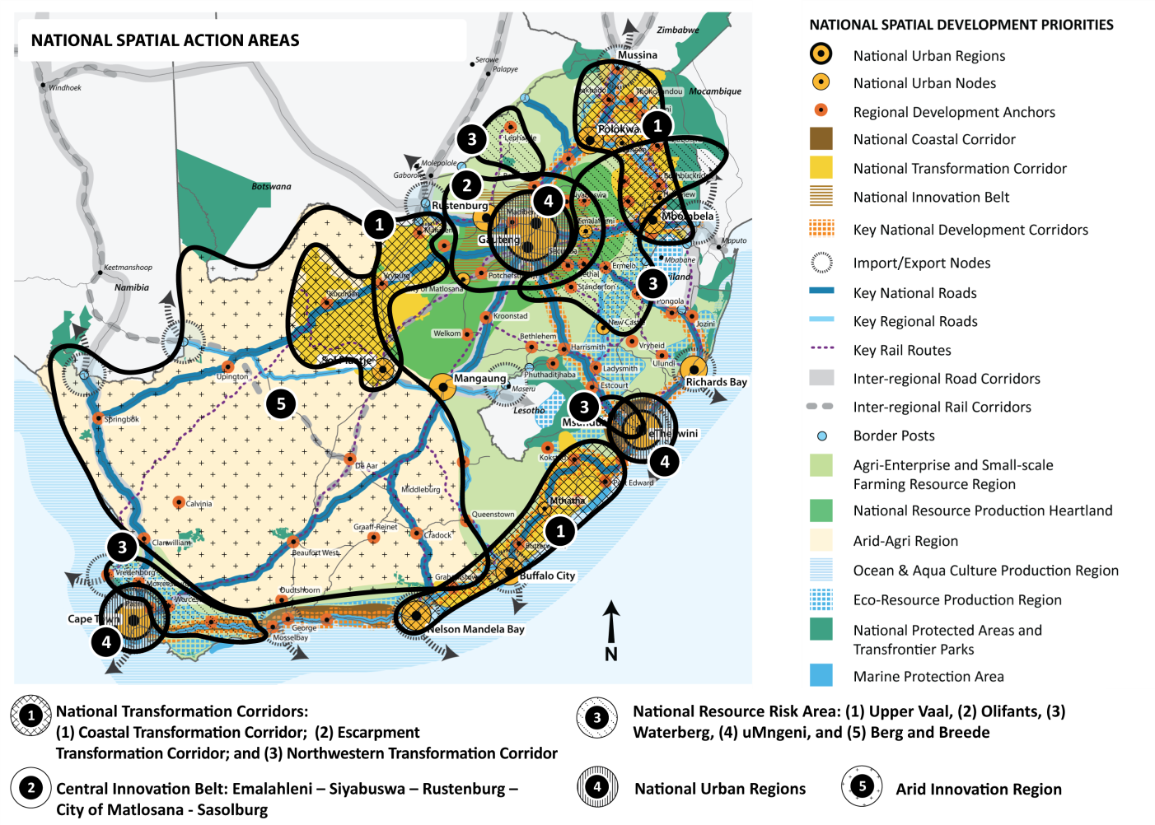
5. NATIONAL SPATIAL ACTION AREAS
Most urgent short-term, strategic spatial development catalysts in the form of National Spatial Action Areas
These national spatial development priorities are informed by: (1) the challenges and trends most likely to impact our country, (2) development objectives in national and provincial development and sector plans, and (3) the gap between our national spatial development vision and status quo.
These national spatial development priorities seek to: (1) identify urgently required interventions in national space and priority spatial development enablers for accelerated development impact in this space, and (2) ensure the restoration, management and sustainable utilization of our country’s rich natural resource foundation and ecological infrastructure.
Notes:
NATIONAL TRANSFORMATION CORRIDORS
While each of these three corridors are unique, they share many similarities: They all have and are projected (1) large, youthful populations, (2) shared histories of deep deprivation and neglect as former Apartheid Bantustans, (3) high levels of poverty and unemployment, and (4) dense and sprawling rural settlement forms (5) Unrealised economic potential due to lack of infrastructure investment and facilitation for economic growth.
Corridor Significance: Will also be called upon to provide (1) water and food, (2) key ecosystems services, and (3) a place where a large number of South Africans will call home, due to the relatively more favourable climatic conditions in these parts of the country vis-à-vis far less favourable conditions envisaged in the western, north-western and central parts of the country.
(1) bring about transformation in the national spatial pattern,
(2) enable national and regional-scale climate and developmental adaptation, and
(3) achieve developmental impact at scale
Strengthen and Consolidate Corridors and the activities, human settlements so that they have a greater social and economical impact
CENTRAL INNOVATION BELT – Unsustainable over reliance on mining sector for economic development – job losses
PROPOSALS OVERVIEW:
Support large-scale regional economic and employment change through innovation, diversification of the economy towards other sectors , adaptation and repurposing of existing industrial land and infrastructure
Expedite urban and rural land reform
Consolidate existing small-and-medium-scale agriculture support programmes
Protect and optimize high-value agricultural land and optimize job-intensive agro-processing
Introduce a special collaborative programme in government, involving universities, research councils, the private sector and communities, to ensure (1) innovation and economic diversification, and (2) quality human settlement development and job-creation at scale
NATIONAL RESOURCE RISK AREA - trade-offs between water, food and energy security in these areas and the ecological implications.
ARID-INNOVATION REGION
Western and southwestern central parts of the country.
Arid and sparsely populated. It is set to be significantly affected by future climate change trends, notably
much higher temperatures – speculated 4 degrees
Very limited availability of water
(3) less rainfall in large parts of the region, requiring a consolidated response.
Heavily reliant on a single economic sector, typically agriculture or mining
For each Strategic Spatial Action Area :
Challenges and Opportunities are discussed
Proposals to guide development in the area

Slide 9
6. NATIONAL SPATIAL ACTION AREAS
Notes:
While these three corridors each have their own unique contexts and challenges, they share many similarities: They all have (1) large, youthful populations, (2) shared histories of deep deprivation and neglect as former Apartheid Bantustans, (3) high levels of poverty and unemployment, and (4) dense and sprawling rural settlement forms.
National Coastal Transformation Corridor and the Eastern Escarpment Transformation Corridor, will also be called upon to provide (1) water and food, (2) key ecosystems services, and (3) a place to call home for a large number of South Africans, due to the relatively more favourable climatic conditions in these parts of the country vis-à-vis far less favourable conditions envisaged in the western, north-western and central parts of the country.
(1) bring about transformation in the national spatial pattern,
(2) enable national and regional-scale climate and developmental adaptation, and
(3) achieve developmental impact at scale
Strengthen and Consolidate Corridors and the activites, human settlements so that they have a greater social and economical impact – KZN Port Shepston to Richards Bay; Garden Route
For each Strategic Spatial and Implementation Action Area the following are discussed:
Challenges and Opportunities in the Regional and National Context
Proposals to guide development in the area
PROPOSALS OVERVIEW:
Enhance cross-boundary spatial development collaboration
Strengthen small-and-medium sized farming activities, agro-eco production and agri-led industrialization
Ensure protection and management of ecological infrastructure
Create strong and vibrant national urban nodes and cities, viable regional development anchors and rural service centers
Use rural design, rural edges and land administration and reform to ensure innovative settlement planning
Enhance rural-urban and rural-rural connectivity and ICT infrastructure
Plan for and ensure regular infrastructure maintenance
Protect and optimize high-value agricultural land and optimize job-intensive agro-processing.
Develop a network of strong and vibrant emergent cities – where they have shown to be experiencing high settlement densities.
Expedite urban and rural land reform.
(2) Coastal Transformation Corridor
Urban Core: na/a
Regional Development Anchors: Port Shepstone-Margate, Kokstad
Rural Service Centres: Harding
Development within National Coastal Corridors
• The Coastal Growth and Development Corridor along the eastern and south coasts (N2) is supported as an area of strong interconnection between high-value rural resource production, ecological resource regions, popular tourist destinations, comfortable climatic zones and urban nodes.
• This corridor also provides opportunities for the consolidation of existing cities and the development of ‘new’ cities supported by well-developed multi-modal connectivity infrastructure. This requires that:
o Port and airport development be strengthened in support of inter-regional trade flows and efficiency; and
o Small harbour development in support of the fishing, tourism and maritime economy at identified coastal regional development anchor and rural service centres be maintained, expanded and accelerated.
(Strengthen and Consolidate Corridors – KZN Port Shepston to Richards Bay; Garden Route)
Development within National Transformation Corridors
• Consolidate settlement development and support the development of new cities in areas (1) of significant population growth, and (2) that are facing significant challenges and offer sizeable opportunities for transformation.
• Develop regional and municipal resource management, urban-rural and eco-agri development strategies in strategic national water and agriculture production regions.
• Accelerate small harbour development in support of the fishing, tourism and maritime economy in Regional Development Anchors and Rural Service Centres along the coast.
• Undertake integrated human capital development, to enable a generation of young people to reap the benefits of urbanisation through (1) human capital development, and (2) the opening-up of urban economies to enable and support a multiplicity of livelihood options.
• Use land administration and urban land reform to guide the interface between settlement planning, landuse, development and infrastructure planning in fast-growing formal and traditional settlement areas.
• Introduce and upgrade sustainable built environment infrastructure as stimulus to enterprise development, with a focus on (1) housing, (2) basic service delivery, (3) public transport, and (4) rural-urban and rural-rural connections.
• Introduce and/or strengthen effective regional collaboration, partnerships and cooperative governance models, to ensure (1) mutually beneficial natural resource-use and land development, and (2) optimise national, regional and local economic development benefits.
(Develop New Transformation Corridors – E Coastal Mandela via Mthatha to Port Shepstone; E Escarpment Mbombela to Thoyoandou; NW Mahikeng via Vryburg and Taung – Kuruman and Postmasburg and Sol Plaatje)
Develop alongside Inter-Regional and National Freight and Development Corridors
• Consolidate nodal development to support inter-regional development corridors and trade with SADC, which includes (1) a focus on SADC corridors, and (2) improving cost and efficiency at border and port facilities on route, to handle greater international and regional trade flows.
• Strengthen regional trade and flows on existing corridors, to support development of cities and towns on these corridors.
• Prioritise infrastructure (ports, harbours and logistics infrastructure) and efficient operations of nationallysignificant trade and movement networks.
(Existing National and Inter-regional Freight and Development Corridors to be Strengthened – Significant export and import trade routesfrom Gauteng (1) via the N4 to Komatipoort, (2) via the N3 to eThekwini, and (3) via the N1 north to Musina.)

Slide 10
7. NATIONAL SPATIAL ACTION AREAS
Notes:
PROPOSALS OVERVIEW:
Support large-scale regional economic and employment change through innovation, diversification, adaptation and repurposing of existing industrial land and infrastructure
Expedite urban and rural land reform
Consolidate existing small-and-medium-scale agriculture support programmes
Protect and optimize high-value agricultural land and optimize job-intensive agro-processing
Introduce a special collaborative programme in government, involving universities, research councils, the private sector and communities, to ensure (1) innovation and economic diversification, and (2) quality human settlement development and job-creation at scale
CENTRAL INNOVATION BELT
Introduce a special collaborative programme in government (including DMR, DTI, CoGTA, DRDLR, DPME, NT, provincial sector department and municipalities) with a specific focus on ensuring…. quality human settlement development in the region...
Establish a joint public-private action group to manage the… impact of formal and informal urban sprawl….

Slide 11
8. NATIONAL SPATIAL ACTION AREAS
Notes:
NATIONAL RESOURCE RISK AREA - trade-offs between water, food and energy security in these areas and the ecological implications.
Upper-Vaal, Olifants, Waterberg, Umgeni, Berg and Breede River Catchments
(3) National Resource Risk Area - uMngeni River Catchment - Water supply for eThekwini, intensive agriculture and expanding settlements
Urban Core: eThekwini (including Pietermarizburg)
Regional Development Anchors: n/a
Rural Service Centres: GaKeta, Dalton

Slide 12
9. NATIONAL SPATIAL ACTION AREAS
Notes:
NATIONAL URBAN REGIONS
More than half of the country’s population already live in urban regions – majority of high value economic activities – Jobs prospects – social, economic significance.
Develop specific funding, land access, land tenure and service provision mechanisms to (1) enable higher residential densities, (2) provide a range of housing options, (3) alleviate pressure on basic and social service provision, (4) optimise all urban land reform dividends, (5) manage urban growth, and (6) provide effective mass public transport;
National Urban Regions
Consolidate urbanisation in compact, productive, sustainable, inclusive and well-governed urban core regions.
Prioritise infrastructure maintenance to mitigate against the expected impact of natural and climate change-related hazards on large numbers of people, especially the poor and most vulnerable members of society, and avoid repetitive infrastructure-repair costs.
Manage demand and maintain, expand and refocus our infrastructure network, to enable and sustain bulk water supply and energy distribution within and to urban regions.
Effectively utilise, protect and manage high-value agricultural lands, ecological infrastructure and national manmade and natural environmental assets, and mitigate down-stream impacts on water bodies, water catchments and other natural resources.
Actively support national and international programmes aimed at climate change mitigation of CO2 emissions, and introduce local policies and measures to assist such programmes.
Utilise innovation, enterprise development and job creation opportunities in (1) agro-eco-industries, (2) tertiary and service sectors, (3) tourism, (4) knowledge-creation, and (5) cultural and entertainment industries.
Maintain and upgrade road and rail routes in urban regions. Prioritise rail for bulk freight, and improve the affordability of intercity public passenger transport.
(Strengthen and Consolidate Existing Urban Regions)
(1) Greater eThekwini Region
National Urban Region:
Urban Core: Durban, Pietermarizburg
Regional Development Anchors: Scottsburgh
Rural Service Centres: Howick, Merrivale, Hilton, Edendale, Ashburton, Hammarsdale

Slide 13
10. NATIONAL SPATIAL ACTION AREAS
Notes:
ARID-INNOVATION REGION
Western and southwestern central parts of the country.
Arid and sparsely populated. It is set to be significantly affected by future climate change trends, notably
(1) much higher temperatures – speculated 4 degrees
Very limited availability of water
(2) less rainfall in large parts of the region, requiring a consolidated response.
Heavily reliant on a single economic sector, typically agriculture or mining
Pursue regional adaptation, economic diversification and agri-innovation at scale, to ensure greater resilience of livelihoods in the region;I
t is also important to harness the nationally significant opportunities of this region, including its niche agricultural activities and fisheries, mineral deposits, potential for alternative energy generation and contribution to the international scientific community through the SKA.
Limit expansion and development of new settlements in very arid areas. Pursue and support compact settlement development around social service nodes and taxi routes in towns and villages, within assured water availability limits;

Slide 14
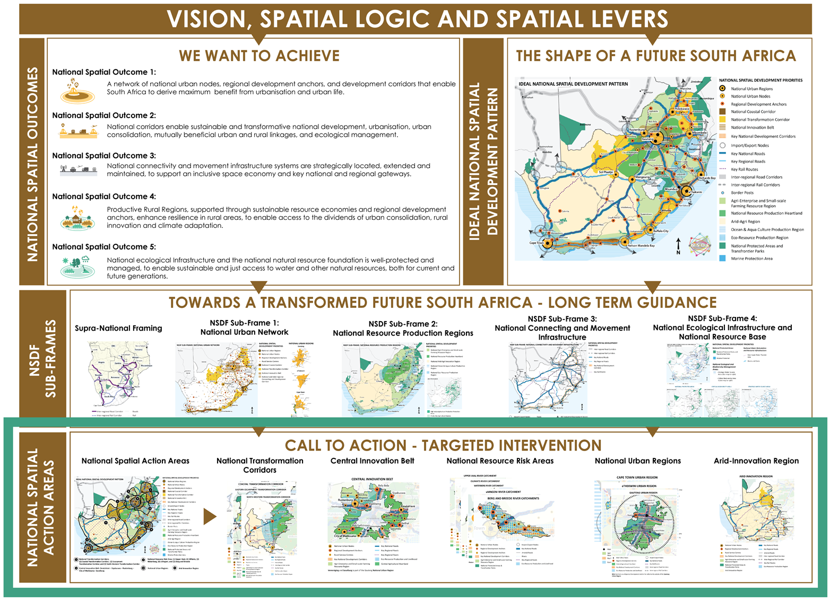
IMPLICATIONS AND CONCLUSION CONT…

Slide 15
7. IMPLEMENTATION FRAMEWORK
Championed
Communicated
Institutionalised at the Centre of Government
Actioned
Embedded

Slide 16
8. Highlights
First legislated spatial instrument guiding National Planning;
Spatial platform for integration of Government Plans and programmes;
Regional approach (interventions across administrative boundaries);
Alignment to NDP and its 5-year implementation plan.
Significant emphasis on spatial integration in the MTSF for 2019-2024, guided by the NSDF.
>>>>>>>>>
>>>>>>>>>

Slide 17
9. UPDATE AND WAY FORWARD
Cabinet approval received for the Minister to publish the Draft NSDF for 60 days for public consultation. Notice published in the government Gazette and advertised on various platforms for public comment – deadline 20 March 2020 e-mail: nsdf@drdlr.gov.za.
Ongoing bi-laterals with national sector departments, SOEs and other non-government stakeholders.
Development of NSDF Implementation Charter/Plan.
Following on from these engagements, the draft NSDF will be revised & amended to factor in comments raised during consultation and produce a Final Draft NSDF for Cabinet approval.
NSDF and MTSF 2019-2024 elevates the role of GIS practitioners in Departments to support geo-spatial analysis, mapping of projects as well as mechanism to illustrate progress with implementation against a GIS backdrop.

Slide 18
For Further Enquiries and Comments:
nsdf@drdlr.gov.za

